Slide 1
The use of spatial planning regulations to protect biodiversity
运用空间规划法规保护生物多样性
Svein Aage Mehli,
斯文·阿格·梅里
Changsha 27 September, 2010
2010年9月27日，长沙

Slide 2

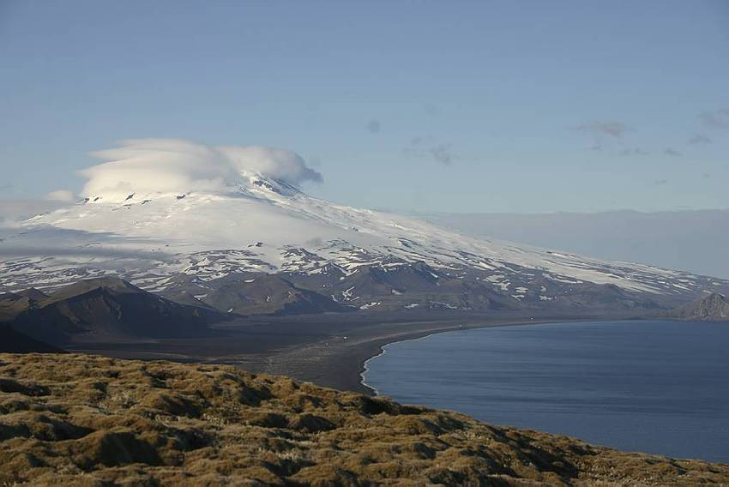
Division of Planning Tasks规划任务的分类
Provide guidelines for planning at regional and local level 为区域或地方层面的规划提供导则
  White Papers白皮书
  National policy guidelines国家政策导则
Resolve conflicts解决矛盾
National 国家层面
  Planning authority:
  The Government
  Ministry of Environment 负责规划的部门：政府环境部
Regional 区域层面
  Planning authority:
  County Council 负责规划的部门：郡参议会
Local 地方层面
  Planning authority:
  Municipal Council 负责规划的部门 ：市参议会
Prepare county plans for the development of the county. Guidelines for planning on local (municipal) level and for sectoral planning 为郡发展准备计划。地方（市）层面的规划导则与部门规划导则
Prepare municipal plans and
legally binding local plans准备市级规划及具有法律约束力的地方计划
Notes:
Planleggingsmyndigheten er knyttet til de 3 forvaltningsnivåene vi har i Norge:
Nasjonalt er det Regjeringen som er planmyndighet. Denne myndigheten er i de fleste tilfeller delegert til Miljøverndepartementet, som ansvarlig planleggingsdepartement
Regionalt er planleggingsmyndigheten lagt til fylkeskommunen, med fylkestinget - et folkevalgt organ - som planleggingsansvarlig. Fylkesmannen, og andre myndigheter på fylkesnivå som representerer staten, har ikke planmyndighet, men er pålagt å delta i den planleggingen fylkeskommunen har ansvaret for.
Lokalt er det kommunene som er planmyndighet. Det er kommunestyrene som har ansvaret for, og som vedtar planer. Det er etter loven et eget politisk planutvalg som forbereder planene for kommunestyret.

Slide 3
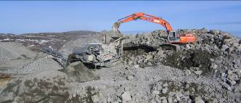
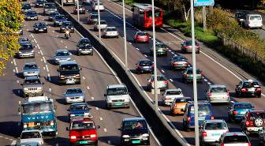

EIA-history – a short summary
EIA历史——简要总结
EIA-regulations in the Planning and Building Act since 1991；1991年《规划与建设法案》中关于环境影响评价的条例
Applicable to plans and projects that have significant effects on the environment, on natural resources or on the community 针对对于环境、自然资源或社区有重大影响的计划或项目开展
1991-2005: 700 EIAs undertaken； 1991年—2005年：共开展了700次环境影响评价
  Extraction of minerals 132 开采矿产资源132例
  Roads 124 道路建设124例
  Industrial and commercial projects 94 工业和商业工程94例
  Wind farms 63 风力发电项目63例
  Hydro power 52 水力发电项目 52例
  ……

Slide 4
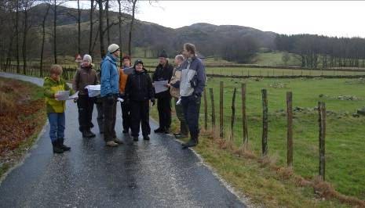
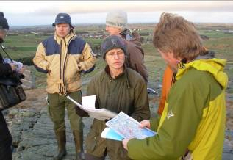
The Norwegian planning system 挪威的规划体系
Main principles:重要原则：
Democratic and decentralized 民主性和分散性
Transparent process 透明的过程
Affected individuals have a right to contribute in the planning process 受到影响的个人有权利参与规划过程

Slide 5
The planning and building act – a vital tool for nature management
规划与建设法案——自然管理的重要工具
14% of norwegian territory controlled by the state (protected areas etc) 国家管控着挪威14%的领土（例如保护地）
86% controlled by municipalities through the use of the planning and building act 各市镇通过运用《规划与建设法案》管控着86%的领土
1 nautical mile outside the sea boundary 领海边界以外一海里
A tool to achieve national aims and policies 一个实现国家目标和政策的工具

Slide 6
The planning and building act
规划与建设法案
New law passed 5. june 2008, enforced 1. july 2009. 新法律2008年6月5日通过，2009年7月1日起开始施行
Purpose: ”…..provide a basis for decisions concerning the 1) use and protection of resources and concerning 2) development and to safeguard 3) aesthetic considerations.” 目的：“……作为进行以下方面决策的基础1）资源的使用与保护，2）发展，以及保证3）美学的考虑”
Important principles:重要原则：
  Knowledge based – no ”I did not know”… 以知识为基础—没有“我不知道”……
  Precautionary principle 预防原则
  Ecosystem approach and total/cumulative effects 生态系统方法与全部（累积）影响
  Polluter pays-principle 污染者付费原则
  BAT – best available technology 最佳可用技术

Slide 7

The regional plan
区域计划
Guidelines for the use of land and natural resources in the county/region 针对在郡或区域使用土地和自然资源的导则
Issues with significant impacts beyond one municipality 产生的重大影响会波及一个市镇以外范围的问题
Issues which must be considered for several municipalities jointly 需要几个市镇共同考虑的问题
May be prepared for specific areas of activity and for parts of the county 可以针对某些活动的特定区域或者郡的某部分

Slide 8
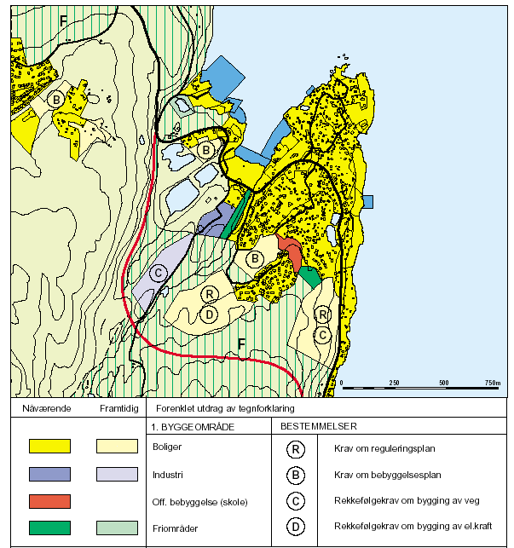
The municipal plan 市计划
To the extent necessary the land use plan shall designate: 在能达到要求的程度上，土地利用规划应该指定：
Building areas 建筑区域
Agricultural / nature /out-door recreation areas 农业、自然和户外娱乐活动用地
Areas for extraction of raw materials 开采矿产原料地区
Areas reserved for defined purposes 为了特定目的保留的区域
Special use or protection特殊使用或保护
    Fisheries, aquaculture, nature, recreation etc 渔业，水产养殖业，自然，娱乐等
Important communication links 重要的交流渠道
Binding 约束力
Every four years 每四年

Slide 9

EIA环境影响评价
The Planning and building act comprise provisions for EIA for plans and projects 规划与建设法案涵盖了针对计划和项目开展环境影响评价的条款

Slide 10
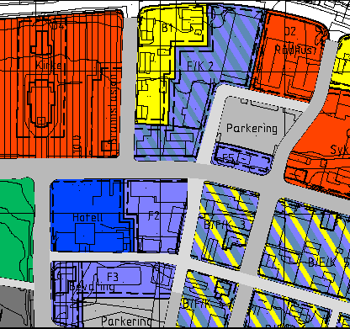
Plans and projects always to be subject to an EIA
计划和项目总是要开展环境影响评价
PLANS计划
Regional plans with guidelines for physical development, i.e wind power development 区域计划，包含针对实体建设的导则，例如风力发电厂建设
The land use part of the municipal master plan 市总体规划有关土地利用的部分
Zoning plans or building development plans for projects listed in Appendix 1 为附录1中项目制定的区划或地产开发计划
National parks and other protected areas pursuant to the Nature Conservation Act 国家公园和其他保护地遵行自然保护法案
PROJECTS项目
Project applications according the list in Appendix 1, i.e wind farms 根据附录1中列出的项目实施项目环评，例如风力发电厂

Slide 11









Plans and projects subject to EIA if significant effects on:如有以下重大影响，则计划和项目必须开展EIA
EIA if in conflict with: 如与以下内容有冲突，必须要开展EIA
valuable nature environments and landscapes 脆弱自然环境和景观
important recreational areas 重要的娱乐区域
cultural heritage 文化遗产
national policy guidelines 国家政策导则
sami activities 萨米族的活动
Agriculture 农业
public health 公共健康
accessibility to public services etc 获取公共服务等
acceptable levels of pollution, noise, safety and natural disasters 污染，噪音，安全和自然灾害的可接受程度
Impacts on other state 对其他国家的影响

Slide 12
Steps in the process
Steps in the process
环评过程中的各个步骤
Steps 步骤 | Responsibility 责任方
Planning programme or study programme 规划项目或研究项目 | Developer开发商
Public consultation 公众咨询 | Comp. authority相关负责部门
EIA programme approval (with possible adjustments) EIA项目审批（有可能进行调整） | Competent authority相关负责部门
Development of plan/application + EIAs 制定计划，执行，进行环境影响评价 | Developer (+ consultants)开发商（+咨询顾问）
Public consultation公众咨询 (Possible supplementary studies + public consultation) 可能需要的补充研究+公众意见征询 | Comp. authority相关负责部门
Decision (approval or not) by competent authority相关负责部门决策（批准或不批准） | Competent authority相关负责部门

Slide 13
Planning/study programme – purpose and content
规划和（或）研究项目——目的和内容
First formalized step/document in the planning/assessment process regarding both plans and projects 在对计划和项目的规划与（或）评估过程中的第一个正式步骤和（或）文件
Describe plan/project and expected issues to be dealt with 描述计划和（或）项目以及期望处理的问题
Describe alternatives 描述替代方案
Clarify the need for and describe assessments to be conducted, including methods 阐明需求，描述需要开展的评估，包括使用的方法
Describe arrangements for information and participation, particularly for groups to be specially concerned 描述对信息（公开）和（公众）参与工作的安排，尤其针对受影响的群体

Slide 14


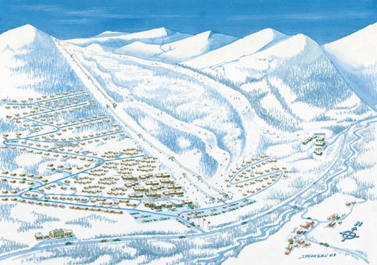
Consultation
– an important part of the process
咨询—整个过程中的重要部分
Sent to all affected parties – authorities, NGOs etc 向所有受影响群体发出通告——政府部门，非政府组织等
Made available for the general public, if possible also on the internet 保证普通公众都可以参与，如果可能的话还应该在互联网上公开
All relevant background material – reports etc be made available from the developer/competent authority 所有的相关背景资料——报告等资料，开发商和（或）相关负责部门有义务提供
Time limit no less than six weeks 时间不少于六星期

Slide 15
Plans or project applications with EIA – some principles开展EIA的计划和项目——一些原则
A planning proposal or project application with EIA should: 一个开展了 EIA的规划建议书或项目需要：
normally be one coherent document – EIA should be an integrated part of the proposed plan or application 提交一份内容完整连贯的文件——EIA应该作为计划或项目的有机组成部分
as far as possible be based on available information and necessary updating of this 尽可能地以可以使用的信息为基础并进行必要的更新
  Experience: field-work often necessary 经验：野外调查通常十分必要
  ”No knowledge” does not equal ”no conflict” “没有相关知识”不等于“没有冲突”
be focused and relevant for the type of plan and the decision to be made 重点突出，与涉及的计划及决策的类型相关

Slide 16
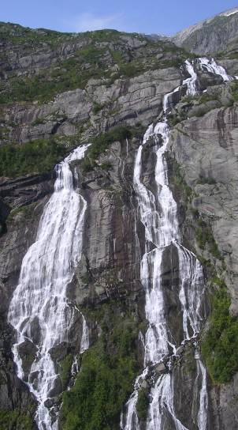
EIA – follow-up
环境影响评价——后续活动
The competent authority must:相关负责机构必须：
explain how complaints and suggestions from the consultation process are taken care of, and how they influence on the final decision 解释如何处理在意见征询过程中收集到的投诉和建议及其对最后决策的影响
establish conditions for the carrying out of the project, to minimize impacts 创造工程实施的条件，以便将影响减至最低
if necessary establish routines for follow-up studies, to verify impacts 如果需要，则制定后续研究的路线以验证影响

