Slide 1
Development and implementation of the Convention on Biologial Diversity in Norway 《生物多样性公约》的发展及挪威履行《生物多样性公约》情况
Svein Aage Mehli,
斯文·阿格·梅里
Changsha, 27 September, 2010
2010年9月27日，长沙

Slide 2
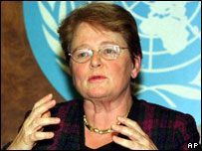
UN and the Environment 联合国与环境
1983: Brundtland Commision – Our common future 1983年：布伦特兰委员会——我们共同的未来
1992: Earth Summit in Rio 1992年，里约地球峰会
Convention on Biological Diversity (CBD) 《生物多样性公约》（CBD）
Framework Convention on Climate Change (FCCC) 《气候变化框架公约》（FCCC）
Convention to Combat Desertification (CCD) 《防治荒漠化公约》（CCD）
Notes:
At the 1992 Earth Summit in Rio de Janeiro, world leaders agreed on a comprehensive strategy for "sustainable development" -- meeting our needs while ensuring that we leave a healthy and viable world for future generations. One of the key agreements adopted at Rio was the Convention on Biological Diversity. This pact among the vast majority of the world's governments sets out commitments for maintaining the world's ecological underpinnings as we go about the business of economic development.

Slide 3
Biodiversity conventions 生物多样性相关公约
Global 全球性
Trade in endangered species (CITES) 濒危物种贸易（CITES公约）
Migratory species (CMS) 迁徙物种（保护迁徙野生动物物种公约）
Wetlands (Ramsar) 湿地（拉姆萨尔公约）
World heritage (UNESCO) 世界遗产（联合国教科文组织）
….
Regional 区域性
European wildlife and natural habitats (Bern) 欧洲野生动物和自然栖息地（Bern，伯尔尼公约）
Polar bears 北极熊
Marine environment, NE Atlantic (OSPAR) 海洋环境，东北大西洋（OSPAR，保护东北大西洋海洋环境公约）
European landscape 欧洲景观
....
http://www.tematea.org/
Notes:
Common frame to adress environmental challenges

Slide 4
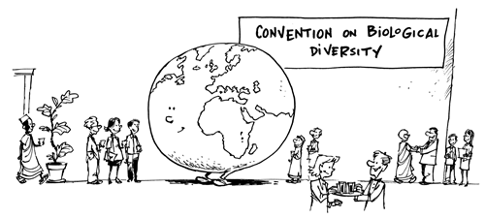
Convention on Biological Diversity 生物多样性公约
First global convention on conservation and sustainable use of all biodiversity 第一个关于保护与可持续利用生物多样性所有组成部分的全球性公约
Legally binding – obligation to implement its provisions, without compliance mechanisms/legal consequences 法律约束力——有责任履行所有的条款，但是没有遵行机制和（或）法律后果
Three main goals:三大主要目标：
Conservation 保护生物多样性
Sustainable use of biodiversity, 可持续利用生物多样性组成成分
Fair and equitable sharing of genetic resources 以公平合理的方式共享遗传资源
http://www.cbd.int/
Notes:
The Convention establishes three main goals: the conservation of biological diversity, the sustainable use of its components, and the fair and equitable sharing of the benefits from the use of genetic resources.
Legally binding; countries that join it ('Parties') are obliged to implement its provisions

Slide 5
Convention on Biological Diversity 生物多样性公约
Issues dealt with under the CBD 生多公约处理的问题
Thematic programmes (marine, inland water, forest, mountain,…) 主题项目（海洋，内陆水体，森林，山地，……）
Cross-cutting (invasive species, impact assessment, development, climate change, monitoring, ecosystem approach,education and awareness,…) 交叉性（入侵种，影响评价，发展，气候变化，监测，生态系统方法，教育与意识，……）
Identifies common problems, sets overall goals, policies and general obligations, organizes technical and financial cooperation, … 明确共同的问题，制定总体目标、政策，确定共同责任，组织技术和财政合作，……
Responsibility for achieving the goals… 有责任实现目标
http://www.cbd.int/

Slide 6
CBD and what it means for Norway 生多公约及其对挪威的意义
CBD – a framework for action 生多公约——行动的框架
Develop national goals and targets based on this framework 在这个框架下制定国家目标和分目标
Develop national biodiversity strategy and action plan (NBSAP) 制定国家生物多样性战略和行动计划（NBSAP）
Integrate these into sector strategies 将国家目标、分目标、战略和行动计划纳入部门战略
Implement action plan 实施行动计划
Report on implementation 汇报执行情况
Notes:
Tilpasse nasjonale forhold etc
Partsland blir sterkt anmodet om å
MDGs – rapportere til 2015 – innlemme post 2010-målene inn i post 2015 MDG-mål

Slide 7
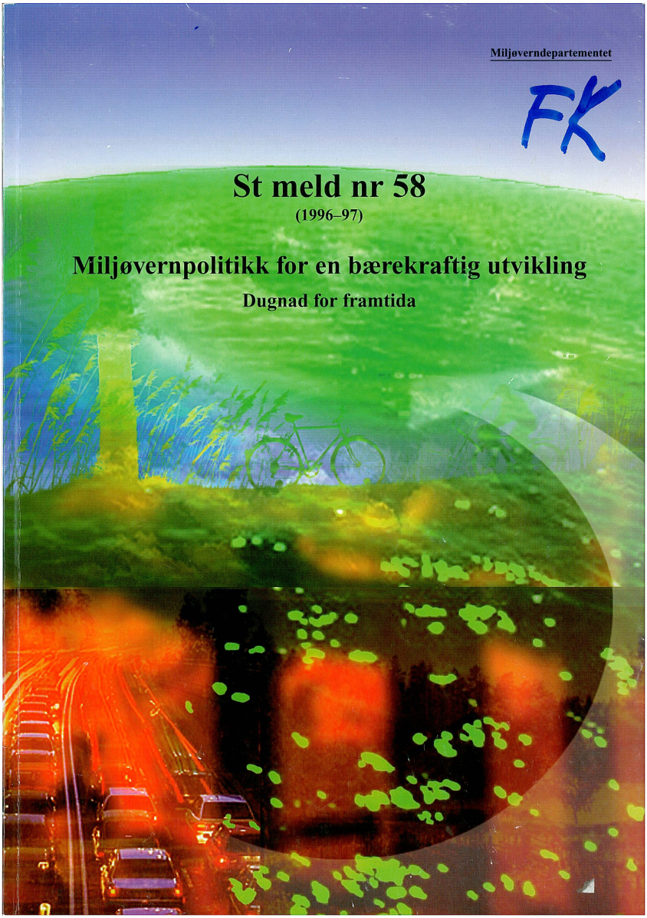
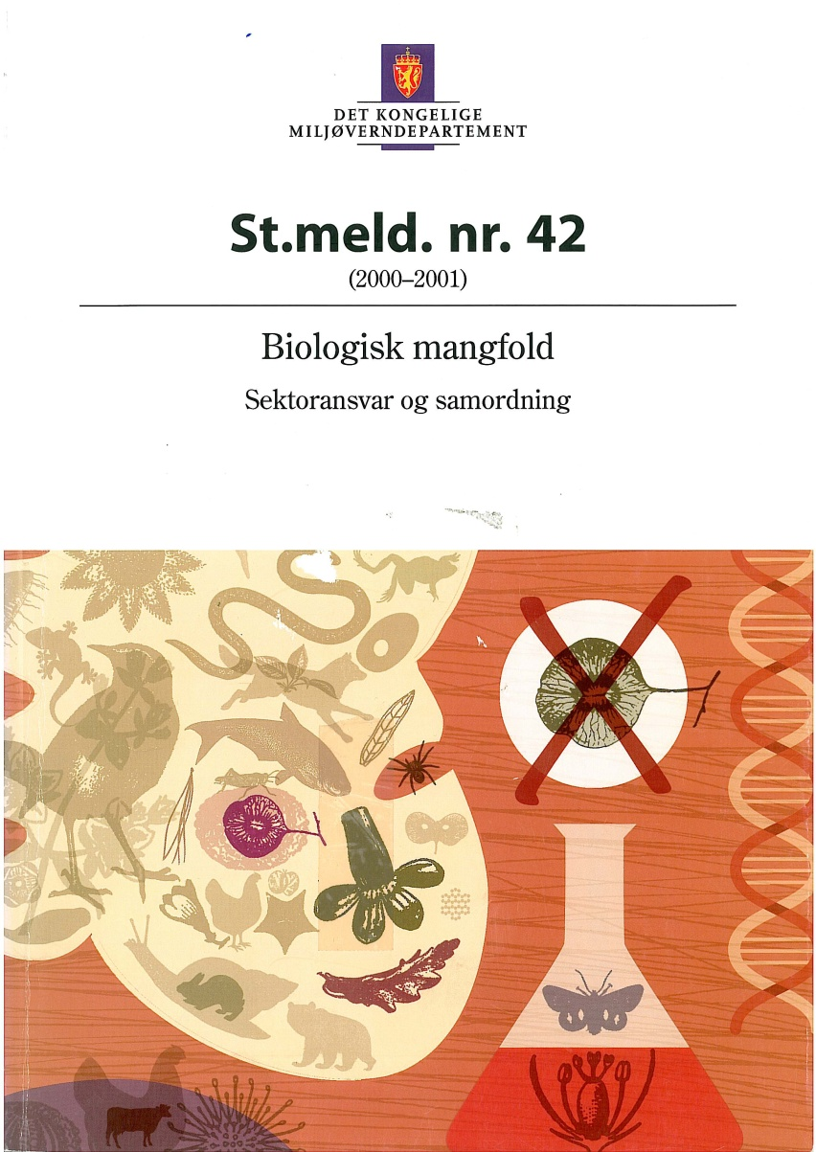
Norwegian biodiversity strategy 挪威生物多样性战略

Slide 8
Goals and targets 目标与分目标
Strategic objective: The environment shall be managed in a way that maintains the diversity of habitats and landscape types and ensures that there are viable populations of naturally-occurring species: this will ensure that biological diversity can continue to evolve. 战略目标：环境管理应该维持栖息地和景观类型的多样性，保证自然演变出的物种能保有维持物种繁衍所需的种群数量：这可以保证生物多样性能够持续进化。
Enhancing sectoral responsibilities and promoting cross-sectoral/horizontal coordination 强化部门的责任，促进跨部门和（或）横向的协调
Improving knowledge of biological diversity 增加对生物多样性的知识
Ensuring sustainable use of biological resources 确保对生物资源的可持续利用
Avoiding the undesirable introduction of alien species 避免无意间引入外来入侵种
Ensuring sustainable land use through planning 通过规划保证土地的可持续利用
Avoiding pollution and waste disposal 避免污染与弃置废物
Enhancing international cooperation 加强国际合作
Ensuring nature diversity as a foundation for Saami Culture 确保自然多样性以保护萨米文化的基础

Slide 9
How is the strategy implemented? 如何实施战略？
Sector integration – sectoral plans and strategies (agriculture, fisheries, energy, infrastructure,…) 部门纳入——部门计划与战略（农业，渔业，能源，基础设施，……）
Ministry – Directorate/Agency – County – Municipality 部—司/局—县—市
Research/ knowledge Institutions 研究和知识机构
Acts and regulations 法案与法规
Nature Diversity Act 自然多样性法案
Planning and building act 规划与建设法案
Petroleum act 石油法案
…

Slide 10
Why sector integration 为什么要开展部门纳入工作？
The economic sectors have the basic responsibility for laws, regulations and activities affecting biodiversity 经济部门对影响生物多样性的法律、法规和活动负有基本的责任
Conservation and sustainable use are two sides of the same coin and must be seen in context 保护与可持续利用是一个硬币的两面，需要在同一个背景下处理
Economic sectors normally have large economic and political power 经济部门通常拥有巨大的经济政治力量
Preventing biodiversity loss is cheaper than restauration防止生物多样性丧失的成本远低于恢复成本

Slide 11
Positive effects of integrated sector responsibility and cooperation on environment 在环境领域增强部门责任、开展部门合作的积极作用
Improved consiousness and responsibility for environment issues at all levels in sector Ministries and institutions 增强了各级部门部委和机构对环境问题的意识和责任感
Additional administrative and financial resources allocated for conservation and sustainable use 为保护与可持续利用活动调拨了额外的行政与财政资源
Active cross-sectoral cooperation established in the management of biodiversity 在生物多样性管理领域开展了积极的跨部门合作

Slide 12
Risks in relation to sector integration 部门纳入生多因素带来的风险
The sector does not follow up due to lack of understanding or little priority 部门由于缺乏理解或没有给予优先考虑导致无法跟进
The sector wants responsibility to control or minimize biodiversity conservation 部门希望有权控制生物多样性保护或将其减至最少
Lack of capacity, resources and competance in the sector 部门缺乏能力和资源，难以胜任
If lack of horizontal cooperation, risks of fragmentation of biodiversity policy 如果缺少横向的合作，则存在生物多样性政策破碎化的风险

Slide 13
Environmental sector in Norway 挪威环境相关部门
Ministry of Agriculture and Food
农业和粮食部
Ministry of the Environment
环境部
Ministry of Petroleum and Energy
石油与能源部
Ministry of Fisheries and Coastal Affairs
渔业及海岸事务部
other ministries其他部委
Directorate for Cultural Heritage
文化遗产局
Directorate for Nature Management
自然资源管理局
Mapping Authority
测绘局
Polar Institute
北极研究所
Pollution Control Authority
污染管制局
National executive and advisory authority on conservation and sustainable use of biological diversity 国家生物多样性保护与可持续利用执行与顾问局
Notes:
We perform national management and advisory duties for global and regional multilateral environment conventions and agreements on biodiversity
We serve as an advisor to Norad (Norw Agency for Dev Coop) on issues related to biodiversity, biotechnology and sustainable use of natural resources.

Slide 14
What have we achieved? 我们取得了什么成果？
Nature Diversity Act 自然多样性法案
Suplements to excisting legislation 对现行法律法规的补充
Common principles for sustainable use 针对可持续利用的共同原则
Common objectives for all sectors 所有部门的共同目标
Precautionary principle 预防原则
Cumulative impacts 累积影响
Polluter pays principle 污染者付费原则
Minimize negative effects 将负面影响减至最低
National programme for mapping and monitoring of biological diversity 生物多样性测绘与监测的国家项目
Changes over time 随着时间推移发生的变化
Causes of changes 变化的原因
Recommendations for measures措施建议
Assess effectiveness of measures 评估措施的效果
Part of reporting to CBD 向生多公约汇报的一部分
Notes:
The Convention on Biological Diversity provides a new international framework for comprehensive management of biodiversity. It is the first major international environmental protection agreement that clearly focuses on the links between the use and conservation of biodiversity and on the equitable sharing of its benefits.
In order to ensure that the Norwegian legislation reflects this
The Act has important supplements to existing legislation; General rules for invertebrates and plants, common management objectives and principles for sustainable use, common rules for harvesting of biological resources, common rules for invasive alien species and a new set of regulations on access and benefit-sharing related to genetic resources
The Act will imply that all sectors that affect or exploit natural resources must put emphasis on common objectives and principles (i.a. precautionary principle, cumulative impacts, principle of payment for affecting the environment (based on polluter pays principle)), as well as minimize negative impacts on biodiversity. The Act puts emphasis on nature’s dynamics and the need for differentiated measures (including legislation and economic incentives) in order to reach the national target to halt the loss of biological diversity.
Trough the process of developing the Act there has been extensive cooperation with all relevant economic sectors and stakeholders.
The goal is to provide information on the location and value of important areas for biodiversity, changes in biological diversity over time, causes of changes, recommendations for appropriate measures, and to assess the effectiveness of measures. It is a requirement that results will be included in national reporting from the sectors via systems for results validation, and in Norway’s international reporting.

Slide 15
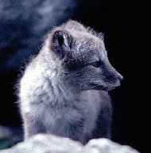
What have we achieved? 我们取得了什么成果？
Management plans for threatened species and natural habitats 针对受威胁物种和自然栖息地的管理计划
Threats 威胁
Remedial measures 补救措施
Monitoring 监测
Red list + Black List 红色名录+黑色名录
Limited probability of survival 有限的生存可能性
Invasive alien species外来入侵种
Notes:
The action plans will identify the threats to the species, current and planned remedial measures, and completed and future monitoring. As of 2008, actions plans for six threatened species, including arctic fox, have been produced. Remedial measures have commenced for all six species. A further 11 action plans are in production. It has been decided to produce 22 new action plans for threatened species and natural habitats, including uncultivated grassy areas formerly harvested for hay (slåttemark), in 2009.

Slide 16
Science-policy interface 科学与政策的结合
Science vs. policy (roles and responsibility) 科学与政策（角色和责任）
Norway: Knowledge-based management 挪威：以知识为基础的管理
Challenge in many countries 很多国家都遇到的挑战
Stern Report and Intergovernmental Panel on Climate Change (IPCC) 《斯坦恩报告》和政府间气候变化专门委员会（IPCC）
Millennium Assessment and Intergovernmental Panel on Biodiversity and Ecosystem Services (IPBES) 千年评估与生物多样性和生态系统服务政府间科学政策平台（IPBES）
Notes:
Sometimes the scientists does not know about important issues in biodiversity etc, and sometimes policy-makers and managers does not know how to use science

Slide 17
Key words in holistic management 整体管理的关键词
Capacity in institutions 机构能力
Start early 尽早开始
Ownership at political level 政治层面的主人翁意识
policies, plans and programmes can be changed/adjusted at political level 政策、计划和项目可以在政策层面进行更改和（或）调整
Stakeholder involvement 利益相关方参与
Identification of stakeholders (Ministries, government agencies, business, NGOs) 确认利益相关方（部委，政府部门，企业，非政府部门）
Sector involvement 部门参与
Baseline data – management of data 基线数据——数据的管理
Notes:
Specific attention to the interests and possibilities of other sectors (agriculture, nature conservation, fisheries, transport etc.) in an early stage increases the chance on identifying new opportunities and balancing short term and long term interests.
Important because oil and gas exploitation usually generates short term benefits with long lasting effects on the environment, economy
Identify stakeholders related to the SEA and planning/development process
Ministries, Agencies, Companies, Local communities
NGOs, General public
Plan and elaborate on involvement in the process from various stakeholders
Capacity and knowledge in institutions: SEA processes, oil and gas exploitation in general
Geodata management
Environment and Oil and gas and vice versa

Slide 18
IMP areas 综合管理计划覆盖地区
Barents Sea (2006)
巴伦支海（2006）
Norwegian Sea (2008)
挪威海（2008）
North Sea (2014)
北海（2014）
Sea area (EEZ) 2 127 192 km²
海洋面积（专属经济区）
Coastline 25 000 km
海岸线
Land area 323 802 + 61 200 km²
陆地面积
Notes:
2002 White Paper:
Important to move step-by-step (prepare 3 successive IMPs), and to learn from experiences along the way.
- hvorfor Barentshavet ble prioritert (s2002: 19-20)

Slide 19
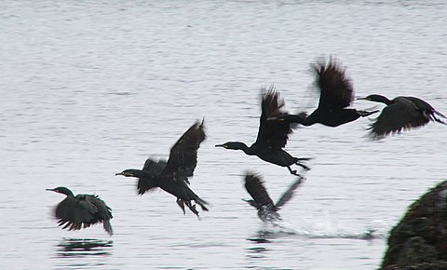
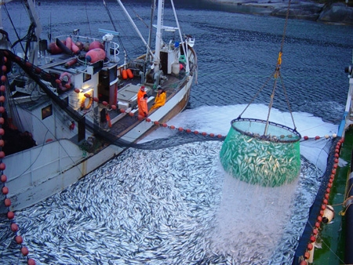
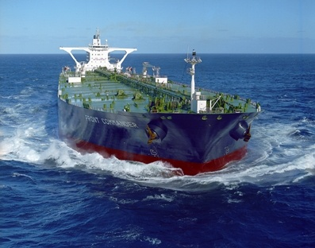
Integrated management 综合管理
- of human activities 人类活动

Slide 20
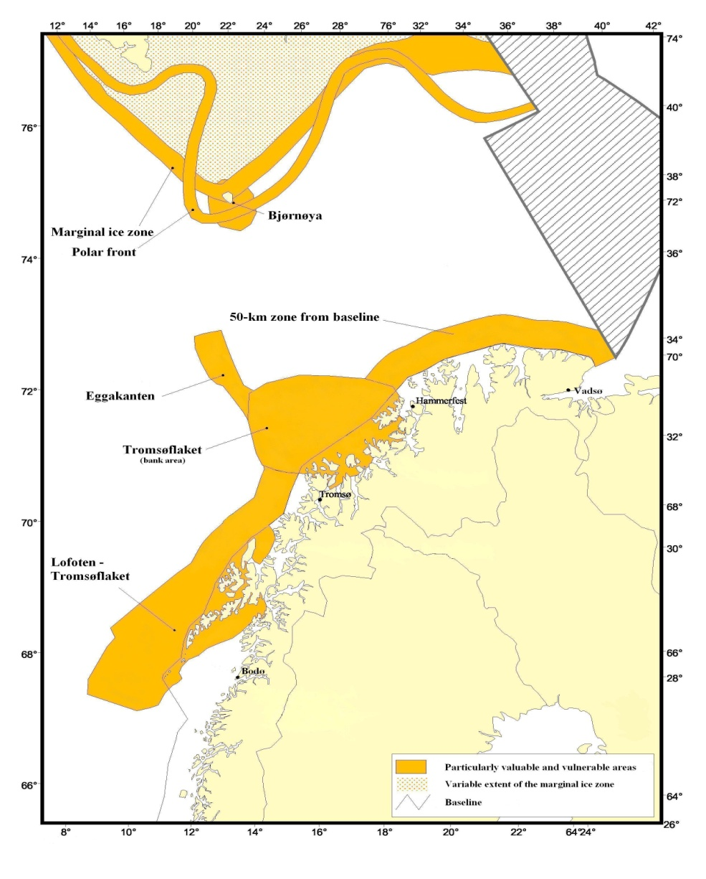
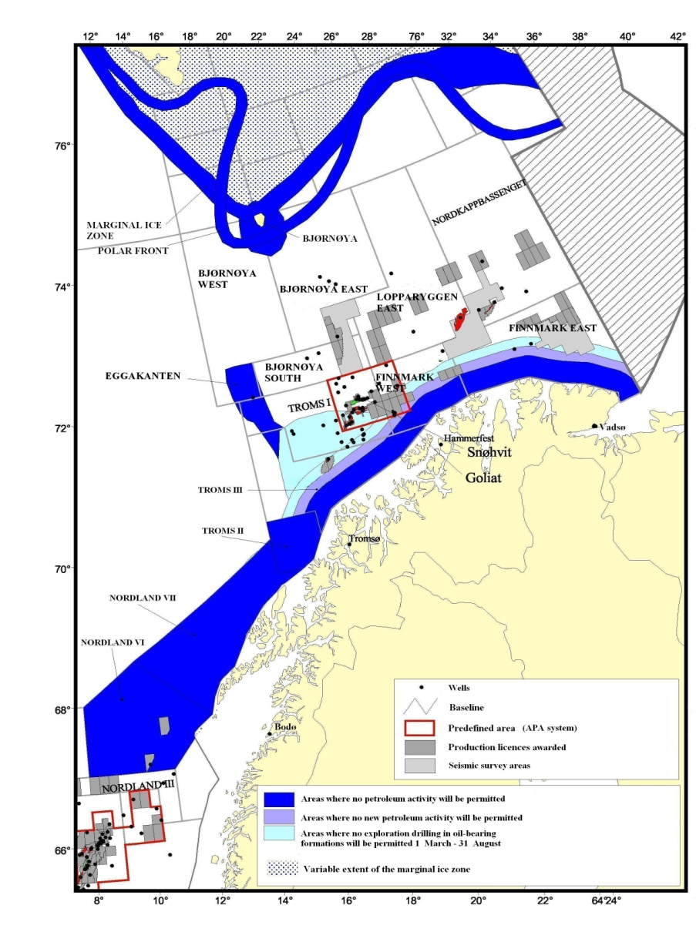
Integrated Management Plan for the Barents Sea: Sensitivity mapping and use in planning processes 巴伦支海综合管理计划：敏感性测绘并应用于规划过程
Particularly valuable and vulnerable areas
特别有价值和特别脆弱地区
Framework for Petroleum activities
开展石油活动的范围

