Slide 1
Norwegian use of the Planning and Building Act to protect biodiversity
挪威运用规划与建设法案保护生物多样性
Svein Aage Mehli,
斯文·阿格·梅里
Changsha 27 September 2010
2010年9月27日，长沙

Slide 2
Basic assumptions to keep in mind
需要记住的基本假设
Democratic tool 民主工具
An EIA is not only for the decisions makers, but also for other affected parties, institutions, NGO’s etc., and the general public 环境影响评价（EIA）不仅为决策者服务，也为其他受影响的群体，机构，非政府组织，普通大众等服务
All data from EIA should be public 所有开展EIA得到的数据都应公开
Transparent 透明
It should be possible to see how conclusions are 应该能够看到结论如何
Knowledgebased 以知识为基础
Decision making should be made on the basis of best possible knowledge 应以能够获得的最佳知识为基础进行决策

Slide 3
What are we basically looking for
我们寻找的最基本要素有什么
Is the EIA according to the terms of reference 是否根据工作大纲要求开展了EIA
Does the EIA cover the most important ecosystems, species etc? EIA是否涵盖了最重要的生态系统和物种等要素？
Does the EIA give relevant information/knowledge? EIA是否给出了相关的信息和（或）知识？
–Baseline 基线情况
–Cause and effect 原因和结果
–Impact/significance 影响和（或）重要性
Does the EIA give alternatives or propose mitagation measures? EIA是否给出了替代方案或者提出了减缓影响的措施？
Is the EIA good enough to make the basis for an ”informed decision”? EIA是不是足够好，可以成为“知情决策”的基础？

Slide 4
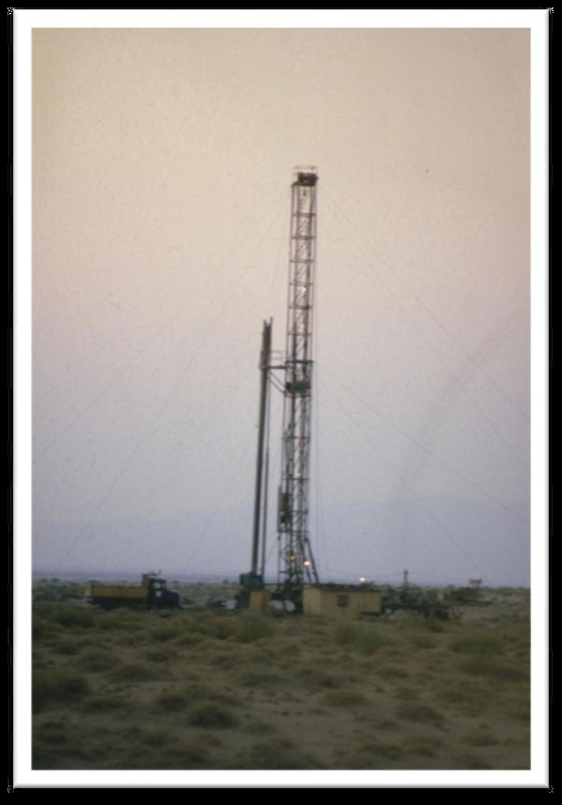
Contents / check list
内容与（或）核查表
Project description 工程描述
• Area of influence 影响地区
• Topics to be assesed 需要评估的内容
–Birds and mammals 鸟类和哺乳动物
–Aquaticlife 水生生物
–Vegetation/flora 植被和（或）植物
• Quality of baseline information 基线数据的质量
• Prediction of what will happen 预测将会发生的情况
• Significance for biodiversity of what will happen将会发生的情况对生物多样性的重要意义
• Cumulative effects 累积影响
• Mitigation and alternatives 减缓措施与替代方案
• Professionality, methodology 专业性，方法论
• Uncertainty 不确定性
• Accumulation of knowledge 知识的积累

Slide 5
Project description 工程描述
Has all relevant parts of the project been described? 是否描述了工程的所有相关组成部分？
  Wells, pipelines, roads, powerlines, buildings, waste deposits etc 钻井，管道，道路，输电线，建筑物，废物弃置等
Has good quality maps been provided? 是否提供了高质量的地图？
  Location: maps on regional and local scale showing location of project area 地点：局域或局部地图指示施工地点
  Plan: how the petroleum plant and infrastructure is distributed within the project area 计划：石油厂与基础设施在施工地区何如分布

Slide 6
Geographical scope 地理范围
Area of influence – how far away from the project may impacts be expected? 影响地区——工程带来的影响波及的距离有多远？
Is the area of influence justified? 是否论证了影响地区？
Variations depending on what kind of biodiversity 根据生物多样性的类型有所区别
  Vegetation/flora: area of influence usually quite local 植被和（或）植物：影响地区通常就是当地范围
  Birds and mammals: area of influence may go far beyond the project area 鸟类和哺乳动物：影响地区可能远远超出施工地区
  Aquaticlife: downstream 水生生物：下游流域

Slide 7
Is biodiversity properly addressed
是否恰当地处理了生物多样性问题？
Have all relevant ecosystem components been
included? 是否涵盖了相关生态系统的所有组成部分？
Ecosystem components 生态系统组成部分
  Vegetation/plants 植被和（或）植物
  Birds and mammals 鸟类和哺乳动物
• Local species, species ”passing through” 当地物种，“途径当地”的物种
  Aquatic species 水生物种
  Ecosystem functions 生态系统功能
If a seemingly relevant ecosystem component is not included, this should be explained and justified 如果没有涵盖明显相关的生态系统组成部分 ，需要对此进行解释和论证

Slide 8
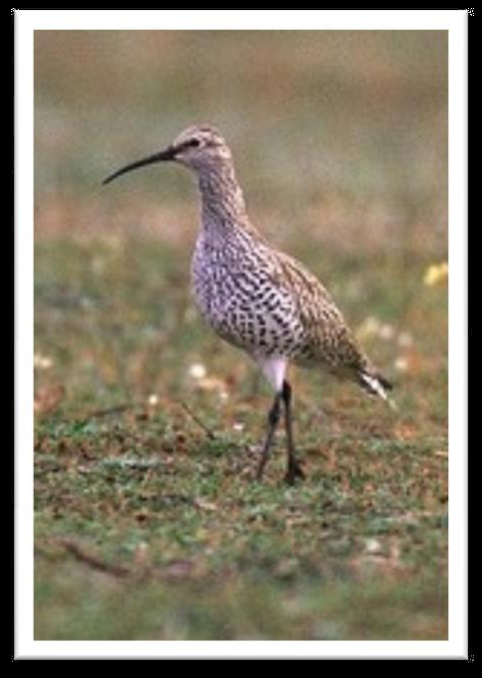
Birds and mammals 鸟类和哺乳动物
Is the whole area of influence covered by the asessment? 评估是否涵盖了受到影响的整个地区？
• Are especially important habitats identified? 是否确认了特别重要的栖息地？
• Are especially vulnerable species identified? 是否确认了特别脆弱的物种（易危物种）？
–Red listed species 红色名录中的物种
–Species covered by international conventions 相关国际公约保护的物种
–National responsibility species/endemic species 国家需要负责物种和（或）特有种
–Species of economic value 具有经济价值的物种
• Is the function of the habitat for the vulnerable species identified? 是否确认了易危物种栖息地的功能？
–Breeding, nesting, foraging, hunting, resting, migration etc.繁殖，营巢，觅食，捕猎，休息，迁徙等
Slenderbill curlew, globally threatened

Slide 9
Quality of baseline information 1
基线数据的质量1
Has all relevant existing knowledge been used? 是否使用了现存的所有知识？
  Data bases 数据库
  Scientific reports/biodiversity sensitivity atlas 科研报告和（或）生物多样性敏感性地图集
  Expert knowledge (authorities, NGOs, other experts) 专家知识（权威机构，非政府组织，其他专家）
  Informal knowledge (local informants) 非正式知识（当地知情人）

Slide 10
Quality of baseline information 2
基线数据的质量2
Has additional field work been carried out? 是否开展了额外的野外调查？
  Where/how much of the area was covered? 覆盖了哪些地区，多大面积？
  When/what time of year/frequence/length of field work? 野外调查的时间、每年的时间、频率、调查的持续时间？
Is it possible to assess the quality of the data? Have the consultants themselves assessed the quality? 有无可能评估数据的质量？顾问是否亲自评估了数据质量？
Important: Zero information does not equal zero value 重要一点：零信息不等于零价值

Slide 11
How is the information presented
如何呈现信息
Is there a good map? 是否有一张好地图？
  Habitats 栖息地
  Migration routes 迁徙路线
  Critical function localities 重要功能地区
Is the information easily understood? 信息是否容易理解？

Slide 12
Have possible impacts on biodiversity been addressed. Direct impacts 是否处理了对生物多样性所有可能的影响。直接影响
Habitat loss or degradation caused by land-take, oil spill, waste etc土地占用、石油泄漏、废弃物等造成的栖息地丧失或退化
Habitat isolation or fragmentation by roads, pipelines etc 由于公路和管道建设等引起的栖息地隔绝或破碎化
Barriers to movement (migration, breeding, foraging etc) 给动物移动造成的障碍（迁徙，繁殖，觅食等）
Disturbance (e.g. by presence of people, vehicles, noise) 干扰（例如，有人在场，机动车辆，噪音）
Alteration of water or hydrological regime 水域或水文规律的改变
Alteration of soil composition 土壤结构的改变
Pollution (direct or diffuse) 污染（直接污染或者扩散）
Introduction or invasion by non-native or overly dominant species 非本地物种或过度优势物种的引进或入侵

Slide 13
Indirect impacts 间接影响
New settlements or new related activities, leading to: 新的移民措施或新的相关活动，导致：
  Increased hunting 狩猎活动增加
  Increased pressure on vegetation for fire wood etc 由薪材采集造成的植被压力增加
  Land take 土地占用

Slide 14
Value and effect 价值和影响
Value价值
  What is the importance of the ecosysten component 生态系统组成部分的重要性
  Is it justified? Which criteria have used.是否进行了充分论证？采用了哪些标准？
Effect/magnitude 影响和（或）量级
  To what degree will the project affect the ecosystem component 项目对生态系统组成部分的影响程度
  Is it justified? Which criteria have been used?是否进行了充分论证？采用了哪些标准？
Low 低
Medium中
High高

Slide 15
Professionality 专业性
Who made the assessment? 谁进行了评估？
  The developer/company? 开发商或公司？
  Independent research institution/consultant? 独立研究机构或顾问？
Are they qualified? 评估人员是否具备资质？
  Authorization system? 授权体系？
  Well known? 声誉高？
Quality may differ between consultants 咨询顾问的资质各异

Slide 16
Cumulative effects 累积影响
Have cumulative effects been assessed? 是否对累积影响进行了评估？
Is the ecosystem components in question stressed by additional impacts? 已受影响的生态系统组成部分是否又受到了其他影响？
  Parallell projects stressing the same components 平行开展的各项工程对同一组成部分造成的压力
  Already existing ecosystem components stressing the same component 已经存在的生态系统组成部分对同一组成部分造成的压力
Focus upon populations of red list species etc. 重点关注红色名录物种的种群数量
Problem: 问题：
  Methodology 方法论
  Knowledgebase 知识基础
Does the assessment add value to the EIA in terms of final decision making? 在进行最终决策时，评估是否为EIA增加了附加价值？

Slide 17
Mitigation 减缓影响
Does the EIA describe mitigation measures? EIA是否提出了减缓措施？
To what degree will these measures avoid, reduce, control, remedy or compensate for negative impacts? Are they justified? 这些措施在预防、减少、控制、修复或补偿负面影响方面的效果和程度如何？是否进行了论述？
Is it likely that mitigation measures will be carried out? 实施减缓措施的可能性多大？
Are impacts described both without and with mitigation measures 是否描述了采取减缓措施时和未采取减缓措施时的影响

Slide 18
Monitoring and evaluation 监测与评估
Does the EIA suggest follow-up activities? EIA是否提出了后续活动建议？
BACI: Before–after–control–impact BACI模型：之前——之后——控制——影响
Study what happens to biodiversity when the project is operating 研究当工程开始实施后多生物多样性的影响
Verify predicted impacts 验证预测到的影响
Accumulation of knowledge 知识的积累

