Slide 1


Ecosystem services - values and uses - Norwegian policy and management
China-Norway Competence-project
Wuhan 12.9. 2012
Peter J. Schei

Slide 2
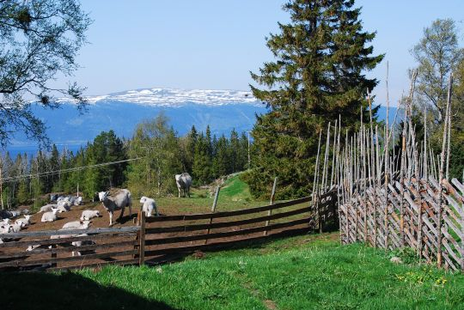
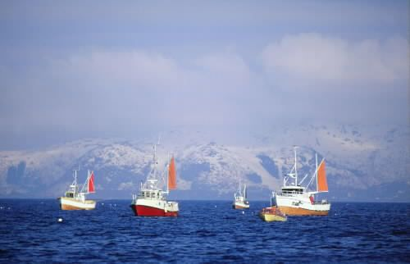
Presentation overview
Introduction
  Ecosystem services
  MA and TEEB study
  International follow-up
Norwegian follow-up
  Expert commission
  Other examples
Questions and comments

Slide 3

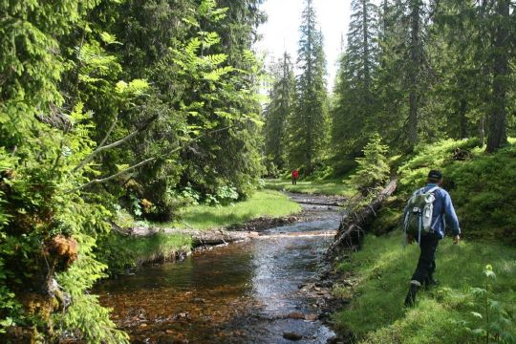
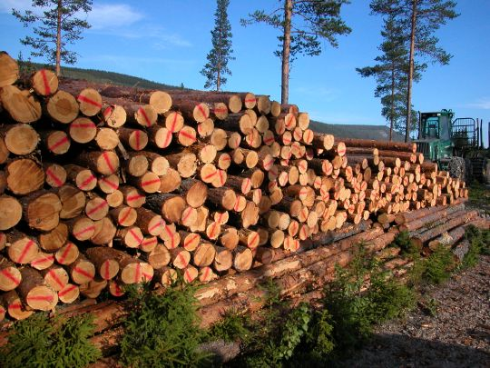
Why conserve biological diversity?
Intrinsic value of biodiversity
Foundation for human welfare and economic activity
Life insurance and basis for sustainable development
Source of knowledge and nature experiences

Slide 4
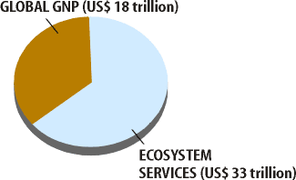
After Costanza et al. (Nature,1997)

Slide 5
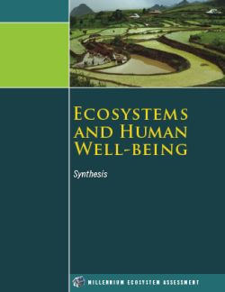
“Benefits people obtain from ecosystems”

Slide 6
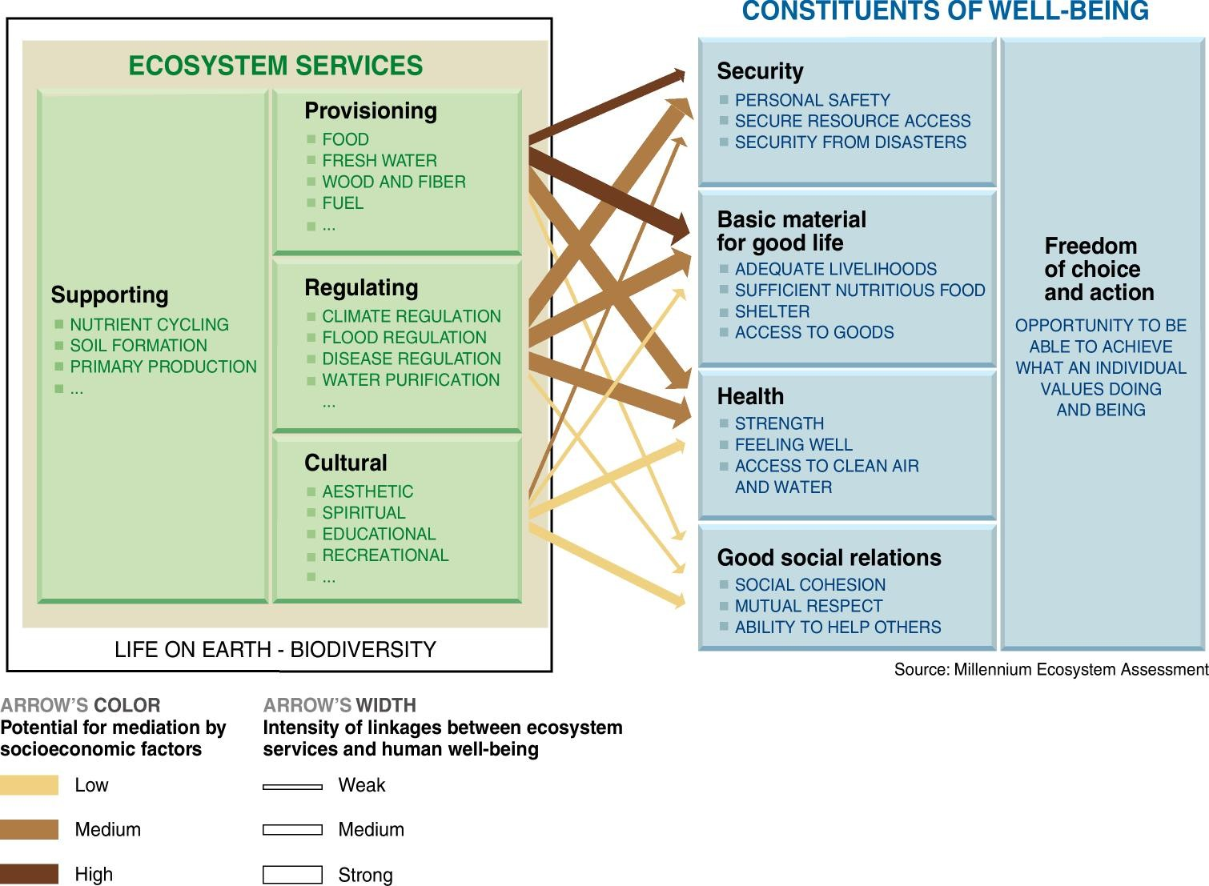
Økosystemtjenester gir oss mye

Slide 7
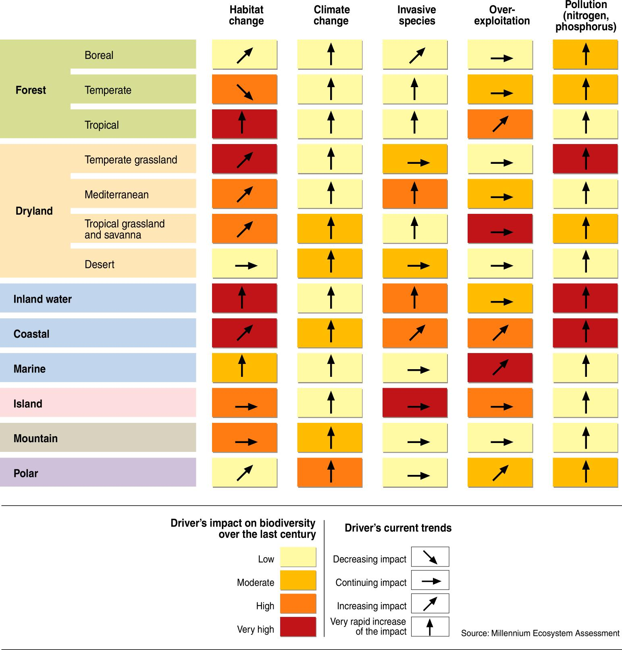
Millennium Ecosystem Assessment 2005
Key reference for under-standing and analyzing ecosystem services
Showed significant pressures on ecosystems
Showed linkages between ecosystem health and human well-being
Important (ecological) foundation for TEEB

Slide 8
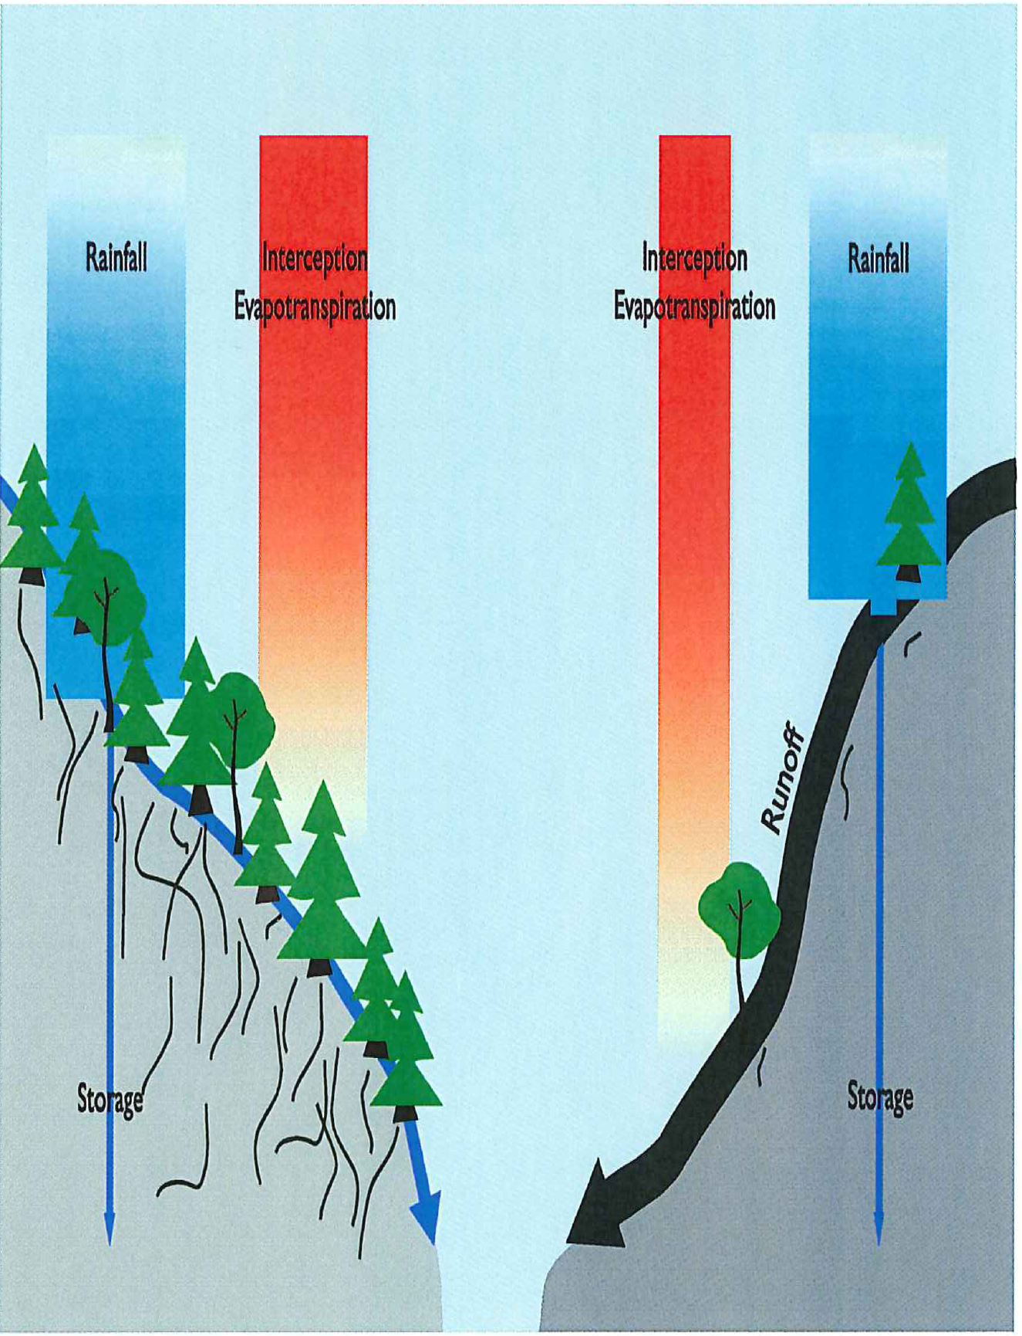
Runoff and sedimentation is reduced by vegetation cover. Intact forests on slopes represents a valuable ES

Slide 9
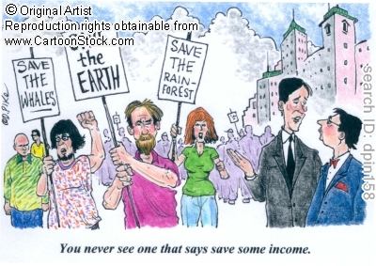

“Environmentalists don’t care about people”

Slide 10
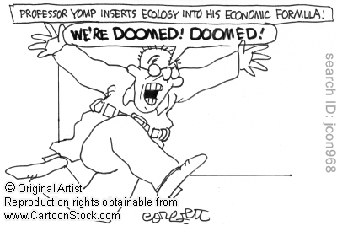
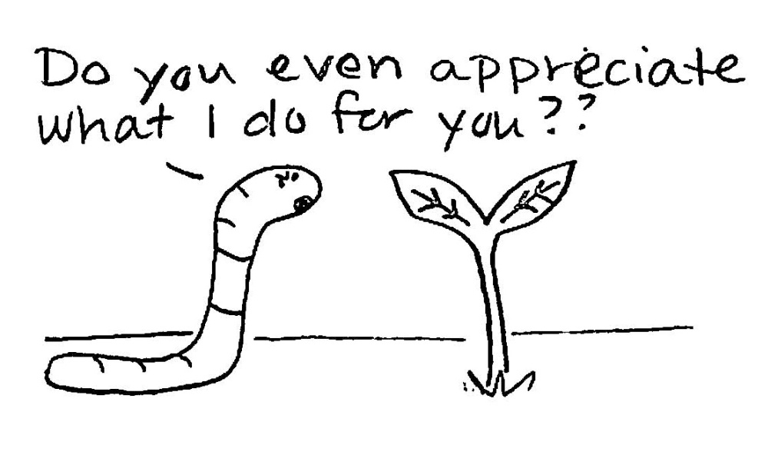
“We don’t understand our dependence on nature”

Slide 11
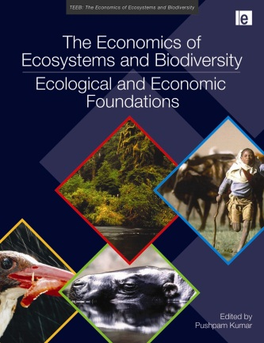
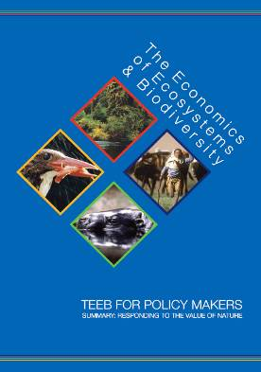
The global TEEB study (2007 –2010 )
Ecological & Economic
Foundations
Policy Evaluation
for National Policy Makers
Assessment and Policies for Local and Regional Policy Makers
Business Risks
& Opportunities
Synthesis

Slide 12

















The TEEB approach
Recognizing value: a feature of all human societies and communities
Demonstrating value: in economic terms, to support decision making
Capturing value: introduce mechanisms that incorporate the values of ecosystems into decision making
Notes:
12

Slide 13
Institutional set up and policymaking. Decisions
Management , restoration
Interaction between valuation and use of ecosystem services
Ø
Biodiversity (all three levels), interaction with substrate
Human well-being. Sociocultural context
Biophysical structures/processes
(e.g. vegetation cover, substrate formation, ecosystem structure)
Functions
(e.g. water regulation, photosynthesis and primary production
Ecosystem services (e.g. production of food and fiber, water and climate regulation, sacred and recreation areas)
Use areas
(health, ecosecurity, nature products, etc.)
(Economic) Value
(e.g payments for goods and services, private and public)
Reworked from TEEB

Slide 14
Understand, describe, measure, value, ...
Knowledge based:
Known and unknown
Ecosystem Services
Qualitative Review
Uses and benefits:
eg. health, income, well-being, security, climate regulation
Quantitative Review
of Effects
Quantification:
eg. number of people using a forest or park for recreation
Monetary
Value
Monetization:
eg. market value of fish or timber

Slide 15

Involves many stakeholders
Environmental policy and management
Economic policy and trade regulations
Transport, energy and mining
Agriculture, forestry, fisheries, aquaculture
Business, public procurement, private consumption
Planning at all levels
Notes:
Chance to influence Env ministers thinking ahead of these events.
15

Slide 16
Helpful for managing trade-offs
Temporal trade offs
  Advantages now, costs later …
Spatial trade-offs
  Advantages here, disadvantages there …
Beneficiary trade-offs
  Some win, some lose …
Service trade-offs
  Manage for one service, lose others …
Trade-off techniques must be developed and introduced into decision-making

Slide 17

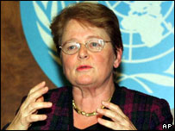

Ecosystem services - international follow-up
International environ-mental governance
Convention on biological diversity (2020 targets)
UNCSD/Rio+20) and role of natural capital in a green economy
PES , Carbon trade
Development arenas
TEEB follow-up
IPBES for science-policy interface

Slide 18
Norwegian general policy on ES and PES
Minister of finance in closing speech to Trondheim conference on Biodiversity (2010) gave strong support to the concepts and recommendations of MA and TEEB
Government decision (2011) to establish a commission to propose how to integrate ES and PES into the overall economy.
Commission's work underway. Will present results sept. 2013

Slide 19
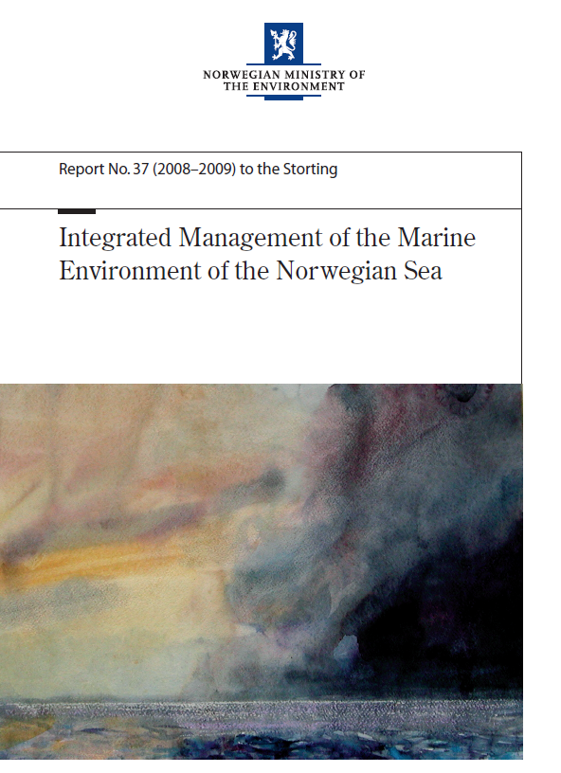
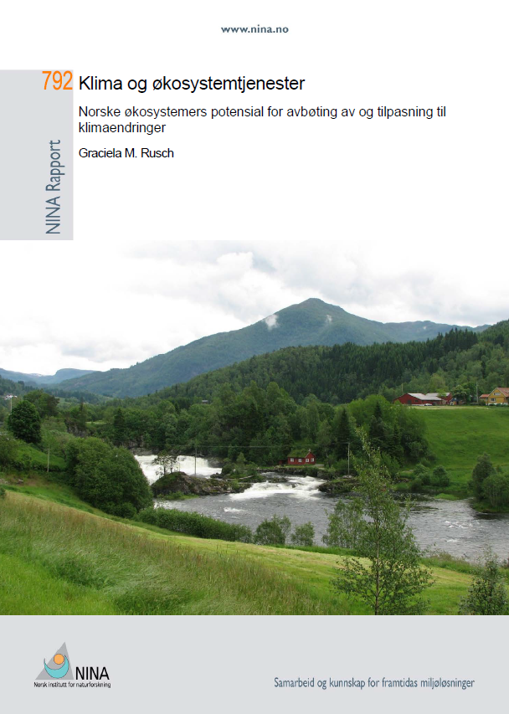
Examples of usage and studies in Norway
Management plans for larger marine areas
Climate change – mitiga-tion and adaptation

Slide 20
Norways International payment for ES
The Norwegian forest and climate project.
Decided by Parliament , up to 3000 million Norwegian crowns pr year up to 2015.
Multilateral(through REDD+) and bilateral payment to selected countries(ex. Brazil, Guyana, Indonesia) for stopping deforestation
Promoting safeguards in climate negotiations for not harming, but enhancing biodiversity in future carbon regulations

Slide 21
National arrangements for PES in Norway
Payment to landowners for establishment of protected areas: 392 million NOK in 2012
Payment to landowners for establishment of outdoor recreation areas: 36 million NOK in 2012
Regional program for maintaining ES in culturally influenced landscapes (MoA): 400 million NOK in 2012
Culture landscape maintenance support(support for non-industrial agriculture+biodiversity conservation)(MoA): 1800 million NOK in 2012
Payment for protection of selected threatened ecosystem types and species: 33 million NOK in 2012

Slide 22
Establishment of an expert commission
An expert commission on the values of ecosystem services was established by the Government through a Royal Decree on 28 October 2011
12 members with broad background and experience
  Chaired by Stein Lier-Hansen, director of Norwegian Industry
  Geographical coverage and key socio-political perspectives
  Academic and professional experience, including in ecological sciences and economics
The commission is to present a Norwegian public report (NOU) to the government by 31 August 2013
  NOUs used by government for clarifying issues

Slide 23
Expert commission mandate
  Consider and extract if and how key terms and approaches from the TEEB study can be used in Norway
  Collect, consider and present knowledge on the values that biodiversity and ecosystem services constitute for Norway today and for future generations
  Explore how knowledge on values biodiversity and ecosystem services can be strengthened
  Propose methods for assessing and valuing consequences for welfare and quality of life resulting from changes in biodiversity and ecosystem services
  Consider how such values can be estimated or valued as part of Norway’s national wealth

Slide 24
Expert commission members
Stein Lier-Hansen | Managing director | Norwegian Industry
Pål Olav Vedeld | Professor | Norwegian University of Life Sciences
Kristin Magnussen | Environmental economist | Sweco Norway
Iulie Aslaksen | Senior researcher | Statistics Norway
Claire Armstrong | Professor | Norwegian College of Fishery Science
Dag Hessen | Professor | University of Oslo – Dept. of Biology
Peter Johan Schei | Adviser/former director | Fridtjof Nansen Institute
Kjell Arne Brekke | Professor | University of Oslo– Dept. of Economics
Signe Nybø | Assistant research director | Norwegian Institute for Nature Research
Kristin Sørheim | Director | Norwegian Institute for Agricultural and Environmental Research
Morten Clemetsen | Associate professor | Aurland Landscapeworks / Norwegian University of Life Sciences
Karl-Göran Mäler | Professor emeritus | Beijer Institute of Ecological Economics

Slide 25
Organization of the commission’s work
Inter-ministerial reference group to be informed about the work and to provide key sectorial perspectives
Should establish contact with interested parties in relevant sectors and organisations
  For example through public consultations
Can as necessary draw on other relevant expertise
  For example through studies and meetings
To draw on experiences from other countries
Secretariat provided by the Ministry of the Environment

Slide 26
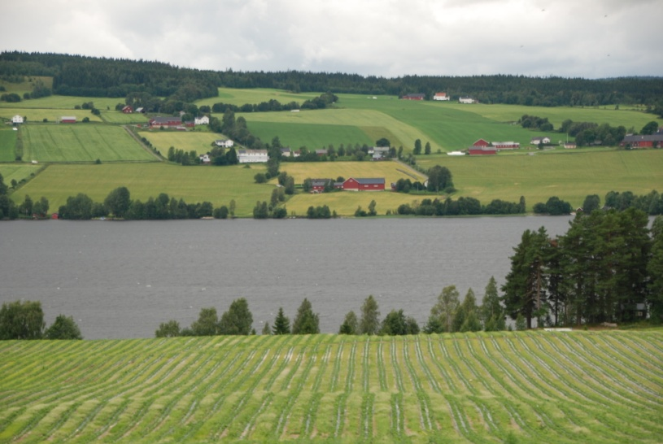

More information
Ministry of the environment home page for the expert commission on values of ecosystem services – www.regjeringen.no/okosystemtjenester
The TEEB study – www.teebweb.org

