Slide 1
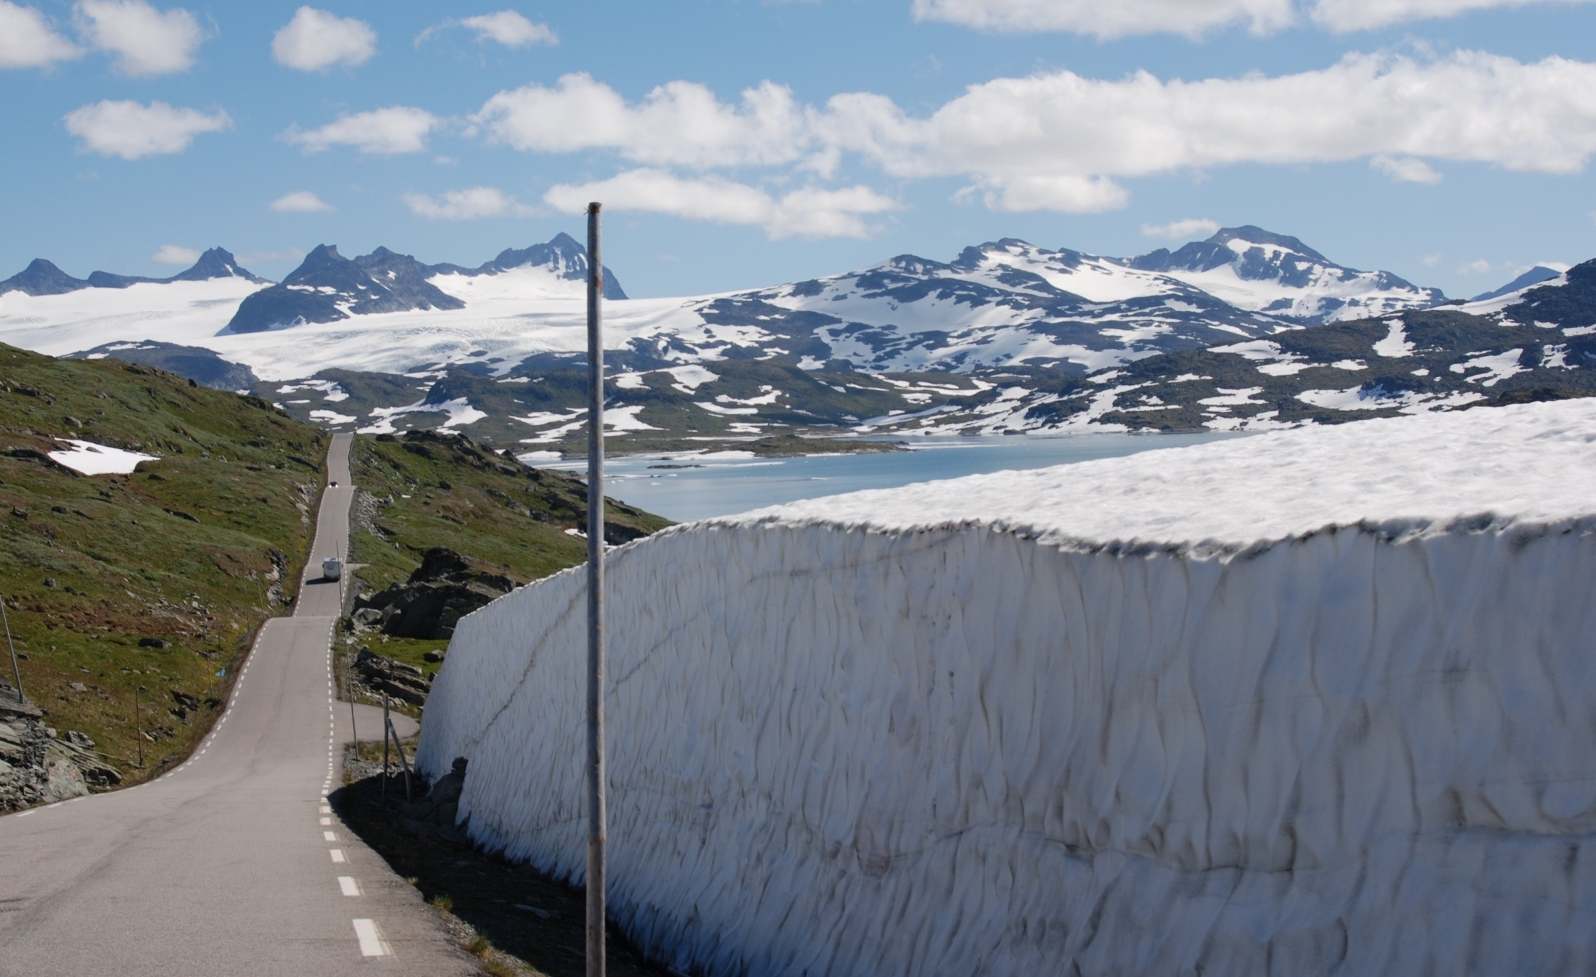
The Norwegian Nature Diversity Act - The main objectives and principles
An Introduction to Norway's Nature Diversity Act and its policy instruments
Mr. Mehli & Mr. Schei
China sept 2012
Torbjørn Lange
Photo: Marianne Gjørv
Foto: Statens Vegvesen

Slide 2
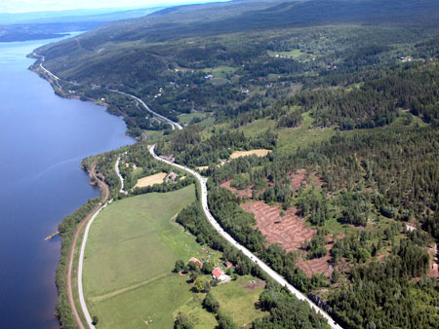
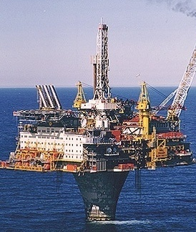
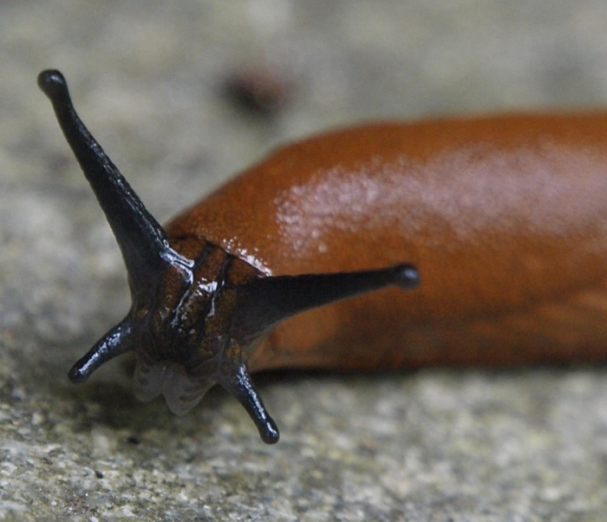
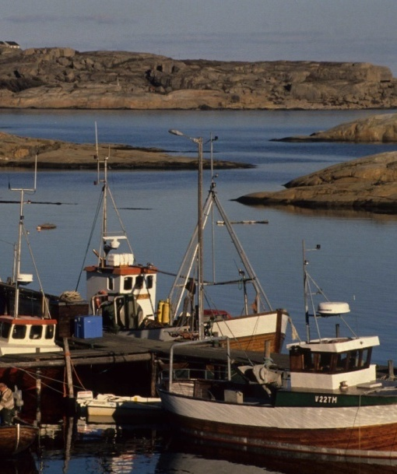
Threats to biological diversity
Land use
Pollution
Photo: Vegdirektoratet
Photo: Marianne Gjørv
Climate change
Alien species
Over harvesting
Photo: Svetek
Photo: Tone Solhaug
Photo: Marianne Gjørv

Slide 3
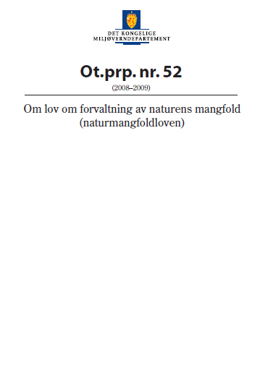
The Nature Diversity Act
An Act consisting of 10 chapters and 77 sections
Chapter I Purpose and scope
Chapter II General provisions on sustainable
use
Chapter III Species management
Chapter IV Alien organisms
Chapter V Protected areas
Chapter VI Selected habitat types
Chapter VII Access to genetic material
Chapter VIII Competent authority
under the Act, supervision, etc
Chapter IX Enforcement and sanctions
Chapter X Final provisions

Slide 4
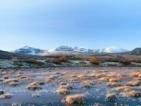
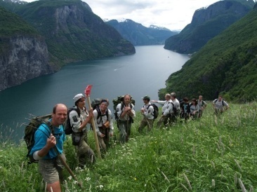
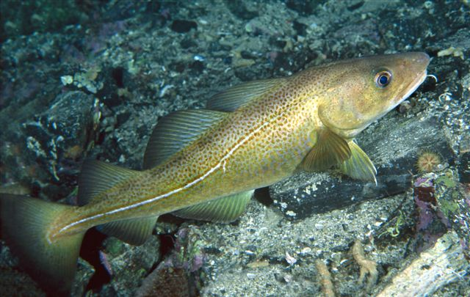
The main parts of the Act
Protected areas, priority species – Nature Diversity Act
Selected habitat types, principles for species management, areas with specific ecological functions and alien organisms – Nature Diversity Act and acts concerning land use, fisheries, forestry, agriculture, mining etc
General provisions and principles – Nature Diversity Act and acts concerning land use, fisheries, forestry, agriculture, mining etc
Source: Ministry of the Environment

Slide 5
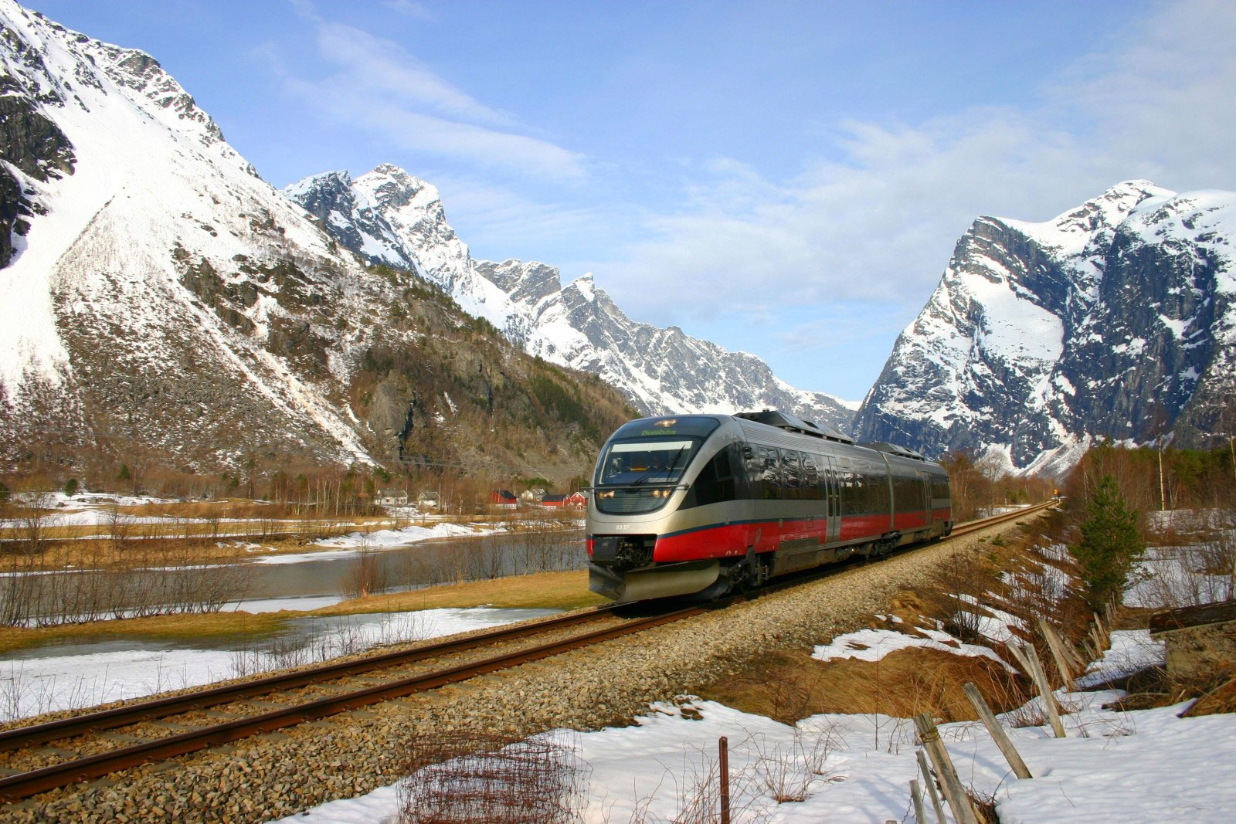
The purpose of the Act
Intrinsic value
Experience and recreation value
Biodiversity is a very important resource
Photo: Leif J. Olestad, NSB

Slide 6
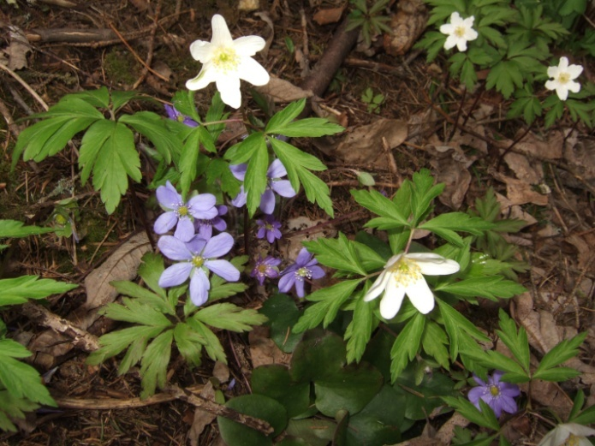
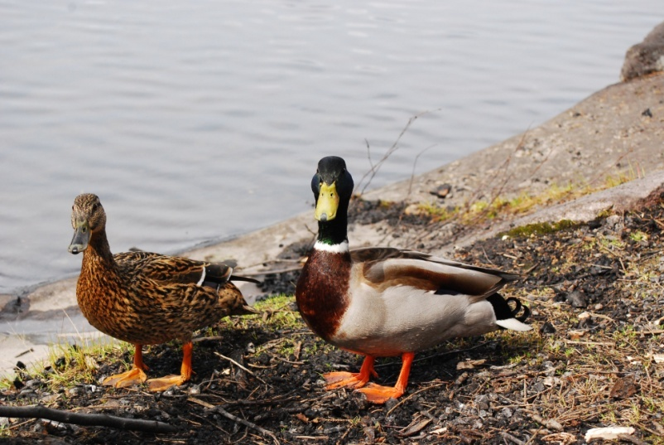
Management objectives
To maintain the diversity of habitat types within their natural range
To maintain species and their genetic diversity for the long term and to ensure that species occur in viable populations in their natural range
Photo: Marianne Gjørv
Foto: Jon Bekken
Foto: Kin Abel
Photo: Marianne Gjørv

Slide 7
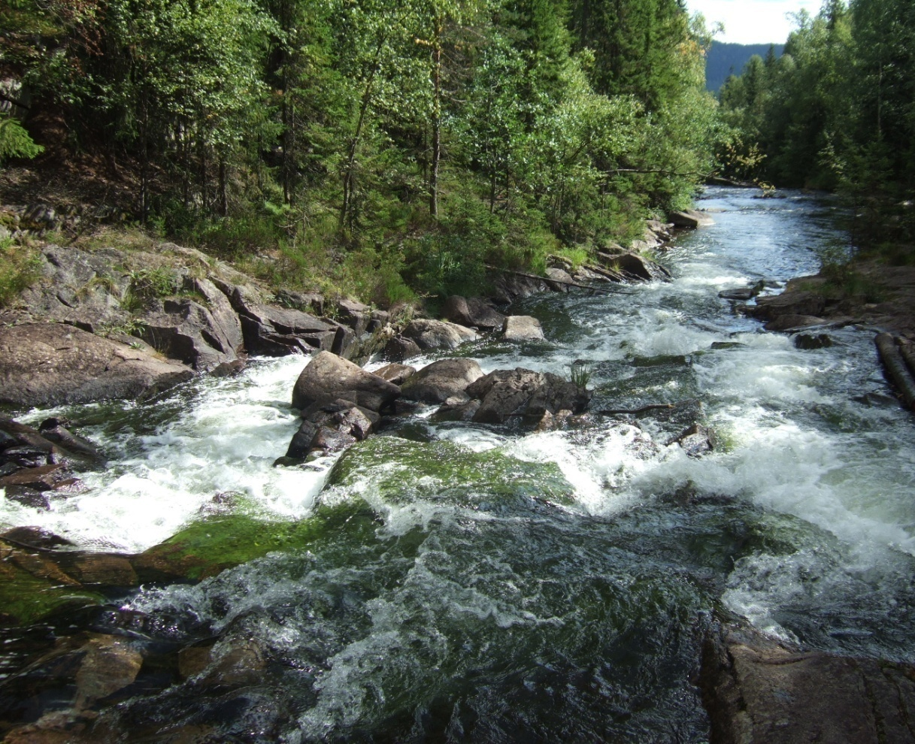
Key principles for sustainable use (1) Ecosystem approach and cumulative environmental effects
Any pressure on an ecosystem shall be assessed on the basis of the cumulative environmental effects on the ecosystem now or in the future
Photo: Marianne Gjørv
Notes:
The first principle says that any pressure on an ecosystem shall be assessed on the basis of the cumulative environmental effects on the ecosystem now or in the future.
Lets me give you an example: If we have a river and there has been allowed 16 small-scale hydroelectric power plants that affects the river, the authorities can say no to power plant number 17, if this - together with the 16 others - will have negative impact on biodiversity.
But this principle also says that the authorities can say no to the first small-scale hydroelectric power plants applied for in a river, if it’s likely that there will be other applications that together with the first one will have negative impact on biodiversity. In these cases the authorities can ask for a holistic management plan for small-scale hydroelectric power plants and the effect they will have on the ecosystems.

Slide 8
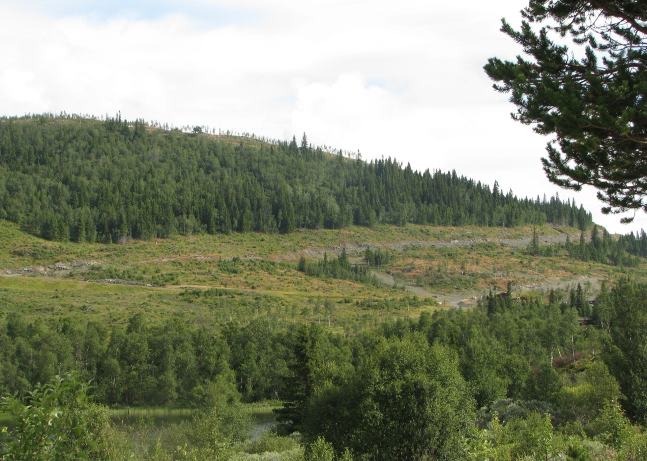
Key principles for sustainable use (2) User-pays principle
Persons responsible for pressure on the environment shall pay to prevent or reduce damage
Photo: Kristin Thorsrud Teien

Slide 9
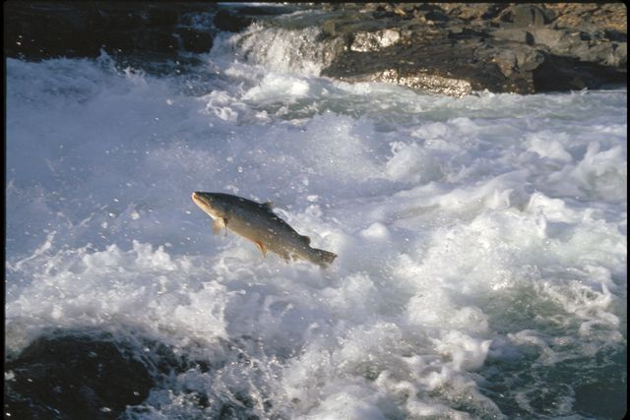
Key principles for sustainable use (3) The precautionary principle
When a decision is made in absence of adequate information, the aim shall be to avoid significant damage to diversity
Photo: Jan Rabben/NN/Samfoto

Slide 10
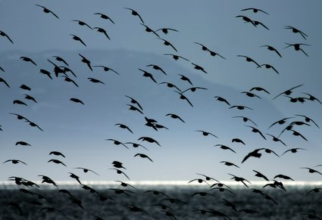
Key principles for sustainable use (4) Knowledge based management
One of the basic fundaments of the Act
Decisions shall be based on:
Scientific knowledge
Knowledge based on experience
Photo: Morten Ekker

Slide 11
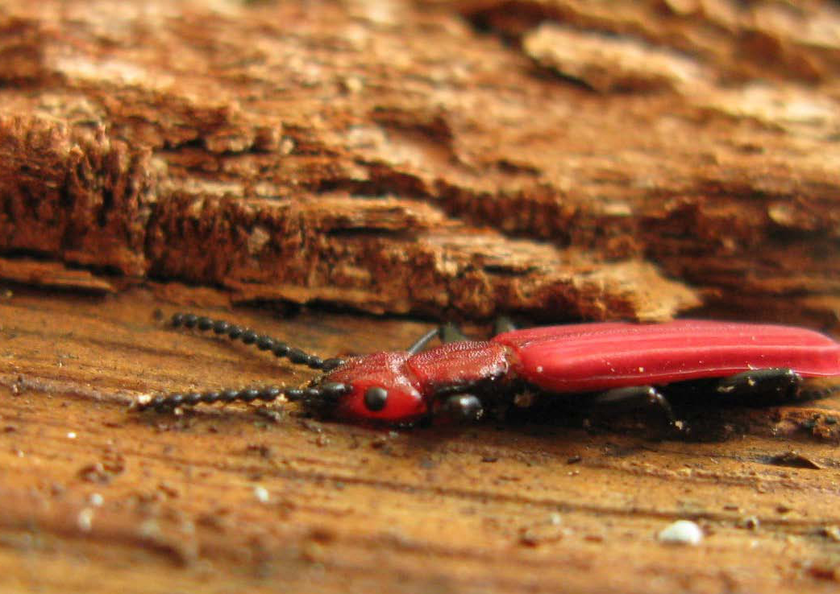
Priority species
Modernization - species and their habitats in context
Establish functional ecological areas for species
Dynamic:
Active measures
Ecological areas are not static
Abolish priority
Cucujus cinnaberinus
Photo: Stefan Olberg

Slide 12
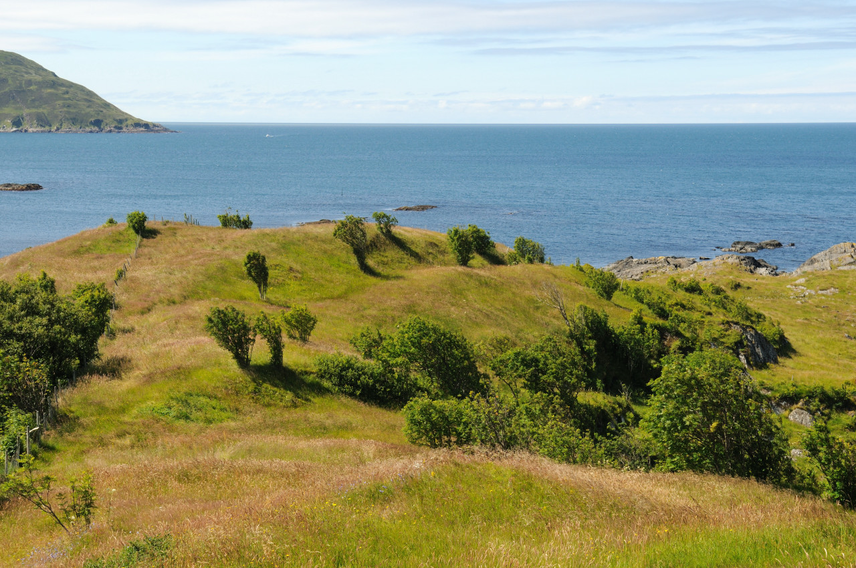
Selected habitat types
Common rules for the management of biodiversity outside the protected areas
The authorities shall take special account of areas of selected habitat types
Increases predictability and responsibility
Hay meadow
Photo: Asbjørn Børset

Slide 13
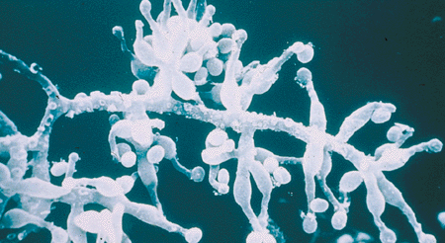
Genetic material
Access to Norwegian genetic resources
Benefit sharing
Genetic material from other countries
Fungus (Tolypocladium inflatum) basis for Cyclosporin A.
Found on Hardangervidda in Norway

Slide 14
Alien organisms
Regulations for import and release
Regulations for combating established alien organisms
Photo: Marianne Gjørv

Slide 15
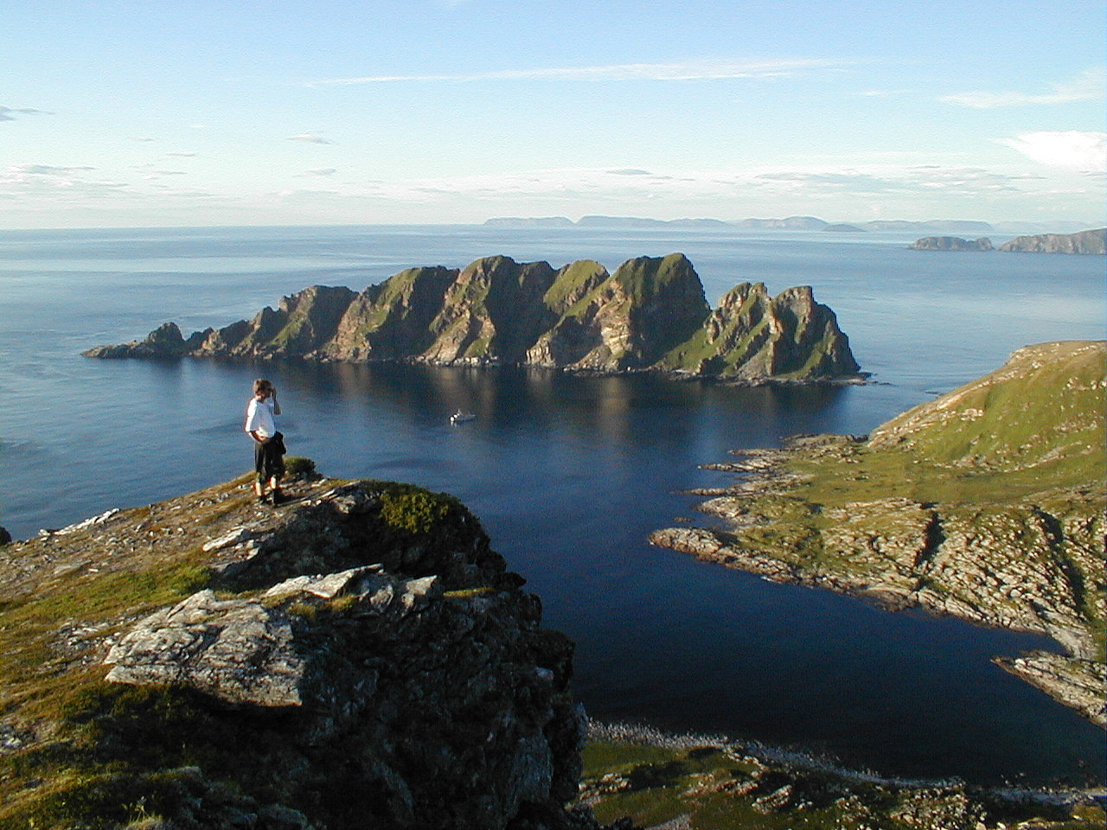
Protected areas
Approximately 16,8 % of the Norwegian mainland is protected
An increased focus on management and maintenance of protected areas
Strategic management plans
Operational management plans
Increased funding
Photo: Torkjell Morset

Slide 16
Summing up – back to the pyramid
Protected areas, priority species – Nature Diversity Act
Selected habitat types, principles for species management, areas with specific ecological functions and alien organisms – Nature Diversity Act and acts concerning land use, fisheries, forestry, agriculture, mining etc
General provisions and principles – Nature Diversity Act and acts concerning land use, fisheries, forestry, agriculture, mining etc
Source: Ministry of the Environment

Slide 17
Thank you for your attention!
Photo: Samfoto

