Slide 1
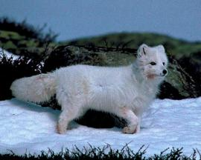
Biodiversity and climate change 生物多样性和气候变化
nature management measures
自然管理措施
Svein Aage Mehli
斯文·阿格·梅里
Senior Adviser
高级顾问
Norvegian Directorate for Nature
Management (DN)
挪威自然资源管理局

Slide 2
International obligations to address the challenges of climate change 应对气候变化挑战的国际职责
UNFCCC – Kyoto Protocol, Bali Action Plan 《联合国气候变化框架公约》—《京都议定书》，巴厘行动计划
reduction of greenhouse gas emissions without negatively affecting biodiversity and ecosystems 减少温室气体排放，同时避免对生物多样性和生态系统造成负面影响
conservation of ecosystems as sinks for greenhouse gases 保护生态系统，将其作为吸收温室气体的碳库
CBD 《生物多样性公约》
take measures to manage ecosystems so as to maintain their resilience to extreme climate events 采取措施管理生态系统，维持其恢复力以应对极端气候事件
Ramsar Convention on Wetlands 《拉姆萨尔湿地公约》
conserve wetlands for increased resilience to climate change 保护湿地，增强其恢复力以应对气候变化

Slide 3
Millennium Ecosystem Assessment: 千年生态系统评估
“climate change is likely to become the dominant direct driver of biodiversity loss by the end of the century” “到本世纪末，气候变化可能会成为生物多样性丧失的主要直接驱动因素”
Consequences for biodiversity and people 带给生物多样性和人类的后果
ecosystem services 生态系统服务
There are significant opportunities for mitigating climate change, and for adapting to climate change while enhancing the conservation of biodiversity (CBD Technical Series No.10) 有很多重要机会可以在减缓和适应气候变化的同时加强生物多样性保护（生物多样性公约技术报告系列卷10）

Slide 4
Institutional responsibilities related to climate change activities in Norway 挪威与气候变化活动相关机构的责任
Ministry of the Environment (MoE) 环境部
responsible for carrying out environmental policies of the Government 负责实施政府的环境政策
influence sectoral Ministries at the national level 在国家层面影响各部门相关部委
Directorate for Nature Management 自然资源管理局
scientific responsibility for nature management and biodiversity conservation in Norway 对挪威自然资源管理和生物多样性保护负有科学职责
instructs the County Departments of Environmental Affairs in areas relating to nature management 在涉及自然资源管理的领域指导郡环境事务负责机构开展工作

Slide 5
DNs responsibility and aim: 自然资源管理局的职责和目标
Maintain a general overview of present and future ecological effects of climate change in Norway 从宏观上掌握气候变化在目前和今后对挪威产生的生态影响
Develop adaptation and mitigation measures 制定适应和减缓措施
Ensure that measures developed within other sectors does not affect biodiversity and ecosystems negatively 确保其他部门制定的措施不会对生物多样性和生态系统产生负面影响
Contribute in the efforts to reduce green house gas emissions (energy, sector cooperation, planning) 为减少温室气体排放贡献力量（能源，部门合作，规划）
Communicate the importance of biodiversity conservation in combating climate change and associated effects 宣传保护生物多样性在应对气候变化及其相关影响方面的重要性

Slide 6
Nature management measures 自然资源管理措施
Report made internally in DN 自然资源管理局内部编写了报告
2 days workshop 为期两天的研讨会
5 groups: 五个工作组
Protected areas and cultural landscapes 保护地和文化景观
Freshwater 淡水
Marine 海洋
Wildlife 野生动植物
Outdoor life/recreation 户外活动/娱乐
Notes:
Ownership

Slide 7
Nature management measures 自然资源管理措施
Summary of some effects of climate change 对气候变化部分影响的总结
Species and populations need to be able to move 物种及其种群必须能够迁移。
Species need large populations with large genetic variation to be able to adapt through natural selection (threatened/Red list species at risk) 物种需要大量种群和基因变异，使物种能够适应自然选择（受威胁的/红色名录中的物种都有危险）。
More pressure on mountainous and Arctic habitats 对山区和北极的生境带来更大的压力。
Climate change will increase the regrowth of traditional cultural landscapes that are disappearing due to changes in land use 气候变化将促进由于土地利用变化而消失的传统文化景观恢复原貌。
Alien invasive species will gain better conditions and become a larger threat to indigenous species 外来入侵种将获得更好的生存条件并对本地物种造成更大威胁。
Increased precipitation gives more runoff. More nutrients in freshwater may lead to lakes becoming choked with vegetation and cause algal blooms 降水量增加造成径流量增加。淡水中的营养物质过多可能造成植被窒息湖泊，引起藻类爆发。
Climate change is a negative factor that comes in addition to a number of other stress factors. The effect of climate change will depend on the cumulative environmental effects 气候变化与其他一些压力因素一起作用时是一个不利因素。气候变化的作用还取决于累积环境影响。

Slide 8
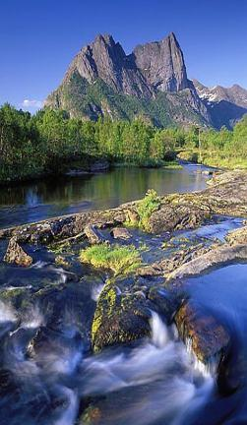
Climate change measures in Norway 挪威应对气候变化的措施
Long-term monitoring 长期监测
Record at the earliest stage possible, negative effects of human activities on biodiversity and ecosystems 尽可能从早期开始记录，人类活动对生物多样性和生态系统的负面影响
Nature types 生态系统
Terrestrial 陆地
Freshwater 淡水
Marine 海洋
Species 物种
Vulnerable species 易危物种
Alien species 外来物种

Slide 9
Climate change measures in Norway
挪威应对气候变化的措施
Management – adaptation and mitigation 管理—适应与减缓
Protected areas and wildlife 保护地和野生动物
Include climate gradients (latitudinal and altitudinal) in present and future protected areas 包括保护地内目前和今后的气候梯度（高度和海拔）
Establish corridors and networks between fragmented habitats/protected areas 在破碎栖息地/保护地之间建立廊道和网络
Avoid fragmentation of ecosystems 避免生态系统破碎化
Ensure strong populations with large genetic variation robust populations are more resistant to climate change 保障巨大的种群数量和遗传变异 强健的种群更能抵抗气候变化
Strengthened control on the importing and spreading of introduced species 加强对引进物种进口和扩散的监管

Slide 10
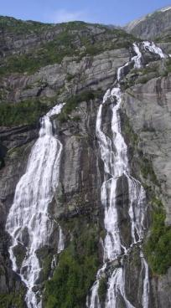
Climate change measures in Norway
挪威应对气候变化的措施
Management – adaptation and mitigation 管理—适应与减缓
Freshwater 淡水
Revision of license terms in regulated rivers (maneuvering rules change, flexible intakes in regulation reservoirs) 修订受调节河流的许可项目（调水规则改变，调节水库灵活调水）
Restoration of rivers and streams 河流小溪的恢复
Establishment of natural bank vegetation as a measure against erosion 恢复河岸的天然植被作为防止水土流失的措施
Control and restriction of introduced species 控制和限制引入物种
Remedial actions against drainage from agriculture 针对农业排水开展补救行动

Slide 11
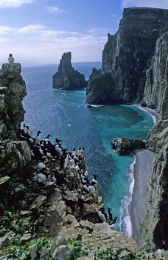
Climate change measures in Norway
挪威应对气候变化的措施
Management – adaptation and mitigation 管理—适应与减缓
Marine areas 海洋区域
Develop ecosystem-based management plans that include climate change effects for all sea areas 为所有海域制定以生态系统为基础的管理计划，并将气候变化影响考虑在内
Establish a stricter regime for determining fishing quotas to counteract large fluctuations in fish populations 建立更加严格的管理制度，根据鱼类种群数量的浮动确定相应的捕捞份额
Keep impacts on ecosystems from petroleum activities, fisheries and emission of toxic substances within sustainable frames 在可持续的框架内避免石油行业活动，渔业和有毒物质排放对生态系统的影响

Slide 12
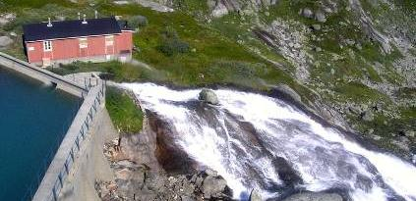
Climate change measures in Norway
挪威应对气候变化的措施
Management – adaptation and mitigation管理—适应与减缓
Renewable energy – biofuel, windpower, hydropower 可再生能源—生物质燃料，风能，水电
Require careful planning – site selection and evaluation to prevent negative effects on biodiversity 需要谨慎规划—选址并进行评估，防止给生物多样性造成负面影响
EIA/SEA 环境影响评价/战略环境评价

Slide 13
Climate change measures in Norway 挪威应对气候变化的措施
Legislative measures and cooperation between sectors 立法措施与部门间合作
adaptation measures are cross-cutting with other sectors need for all sectors to develop adaptation measures within their own areas national adaptation strategy 适应措施是跨部门的措施 需要所有部门在各自的领域制定适应措施 国家适应战略
DN is undertaking capacity building activities for municipalities on how to develop climate and energy plans adjusted for local conditions 自然资源管理局正在帮助自治市开展能力建设活动，协助各市根据各自的具体情况制定气候与能源政策

Slide 14
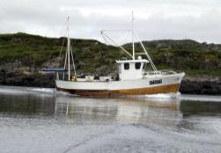
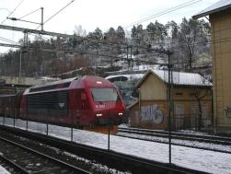
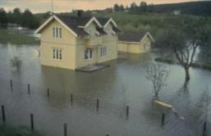
Cross sectorial coordination 跨部门协调
Secretariat for Climate Change Adaptation 适应气候变化秘书处 – at the Directorate for Civil Protection and Emergency Planning 位于国民保护与应急规划局之内 – with steering documents from the Ministry of the Environment 环境部的指导文件
The Norwegian Climate Change Adaptation Programme 挪威适应气候变化项目
Notes:
Part of the general communication that DN has with the different sector in the established working areas
The government's report and the establishment of the Secretariat for Climate Change Adaptation at the Directorate for Civil Protection and Emergency Planning (DSB) in 2007 are new approaches to help achieve a coordinated adaptation. (Normally sorts under the Ministry of Justice)
The establishment of the online portal Klimatilpasning.no and the courses and information activities that have been started by the Norwegian Climate Adaptation Programme secretariat with the Directorate for Civil Protection and Emergency Planning (DSB) are measures that have been initiated under the national coordination work.

Slide 15
National policy 国家政策
Official Norwegian Reports:
NOU 2010: 10
挪威官方报告
Adapting to a changing climate 适应一个变化的气候
Society‘s vulnerability and its need to adapt to the consequences of climate change 社会的脆弱性及其适应气候变化造成后果的需求
Recommendation from a committee appointed by the Royal Decree of 5 December 2008 由2008年12月5日皇家法令指定的委员会提出的建议
Submitted to the Ministry of the Environment on 15 November 2010 于2010年11月15日提交环境部

Slide 16
National policy – three main conclusions 国家政策—三个主要结论
A comprehensive approach to adaptation, always assess greenhouse gas emissions, pollution and the natural environment when adaptive measures are planned 采用综合性的方法处理适应问题，在制定适应措施时，需要一直评估温室气体排放量，污染和自然环境
Management of the natural environment must be based on an ecosystem-based approach 管理自然环境必须使用以生态系统为基础的方法
Adaptation must be integrated into ordinary social planning 适应措施必须被纳入日常社会规划

Slide 17
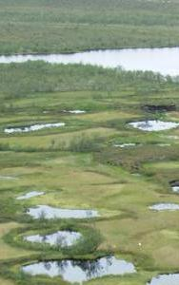
Ecosystems as carbon (C) sinks 作为碳库的生态系统
Intact ecosystems, such as forests and wetlands have large C storage capacity net build up of atmospheric C per year 完整的生态系统，例如森林和湿地，都具有巨大的碳储存能力 每年大气中碳的净含量
Peatlands - most important carbon store in the terrestrial biosphere, storing twice as much carbon as the forest biomass of the world 泥炭地—陆地生物圈中最重要的碳库，其碳储存量相当于世界森林生物量储存碳量的两倍
degradation of peatlands has been contributing annual emissions equivalent to 10% of global fossil fuel emissions 每年因泥炭地退化造成的碳排放相当于当年全球化石燃料排放碳的10%

Slide 18
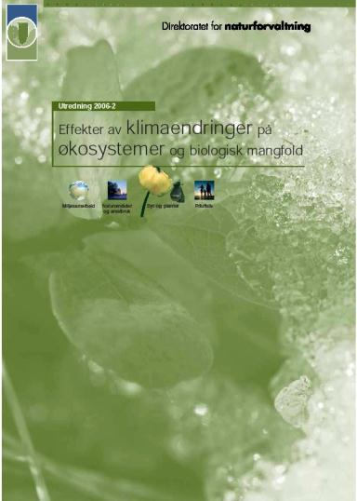
General vulnerability analyses 脆弱性总体分析
“Effects of climate change on ecosystems and biological diversity” “气候变化对生态系统和生物多样性的影响”
- Primarily written by different specialist researchers in different fields/nature types 由不同领域（生态系统）的专业研究人员编写而成
Based on review of publications 以出版物综述为基础

Slide 19
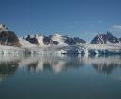
General vulnerability analysis 脆弱性总体分析
Assessed nature types: 评估的生态系统类型
Mountain 山地
Forest 森林
Cultural landscapes 文化景观
Freshwater 淡水
Coastal areas 海岸带
Marine 海洋
Arctic 北极
For each nature type: 针对每一类生态系统：
Description, relevant climate parameters for the nature type 描述与该生态系统相关的气候参数
Documented effects of climate change 记录气候变化产生的影响
Expected ecological consequences, effects on ecological processes 预期的生态结果，对生态过程的影响

Slide 20
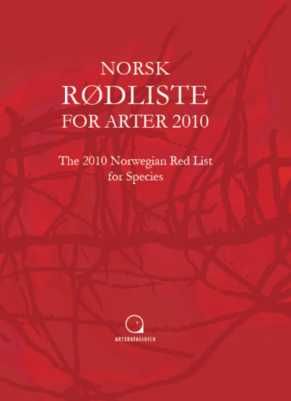
Red list for species 物种红色名录
The 2010 Norwegian Red List for Species 《2010年挪威物种红色名录》
Published by the Norwegian Biodiversity Information Centre 由挪威生物多样性信息中心出版
Based on the IUCN criteria 采用IUCN分类标准
21 000 species assessed, 2398 classified as threatened, 1284 near threatened 评估了21000个物种，2398种受威胁，1284种近危

Slide 21
Red list for nature types 生态系统红色名录
“ The Norwegian Red List for Nature Types 2011” 《2011年挪威生态系统红色名录》
Published by the Norwegian Biodiversity Information Centre 由挪威生物多样性信息中心出版
No IUCN criteria: Developed their own criteria 没有使用IUCN标准：自主制定标准
In principle the same threat-categories as for species 原则上采用和物种相同的受威胁等级
40 nature types classified as threatened (RE, CR, EN, VU) 40类生态系统属于濒危（RE，CR，EN，VU等级别） 31 as near threatened (NT, LC) 31类属于近危（NT，LC等级别）

Slide 22
